Slide 1
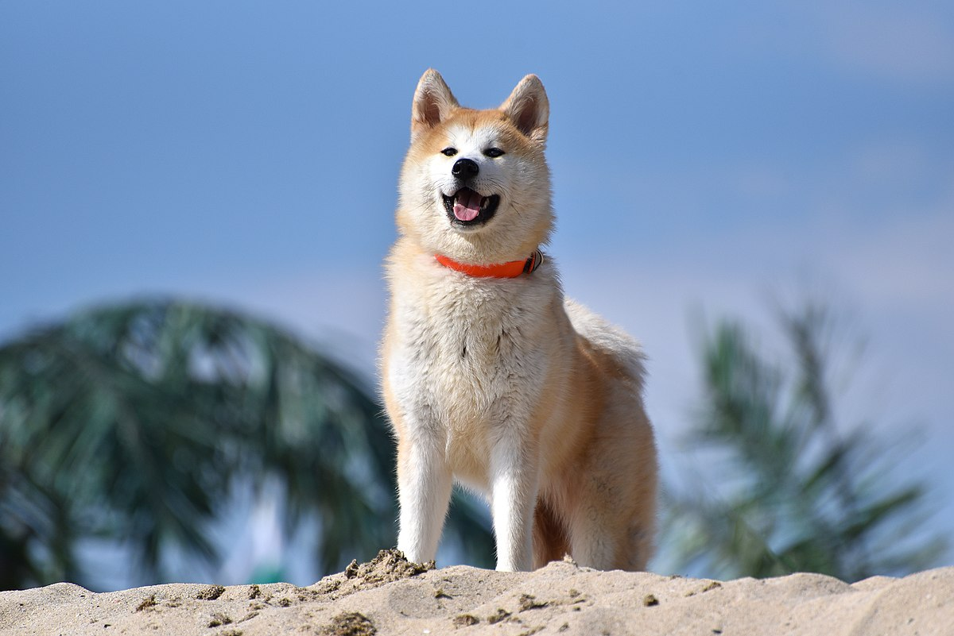
Dog's can dig up the turtles eggs.
This Photo by Unknown author is licensed under CC BY-SA.

Slide 2
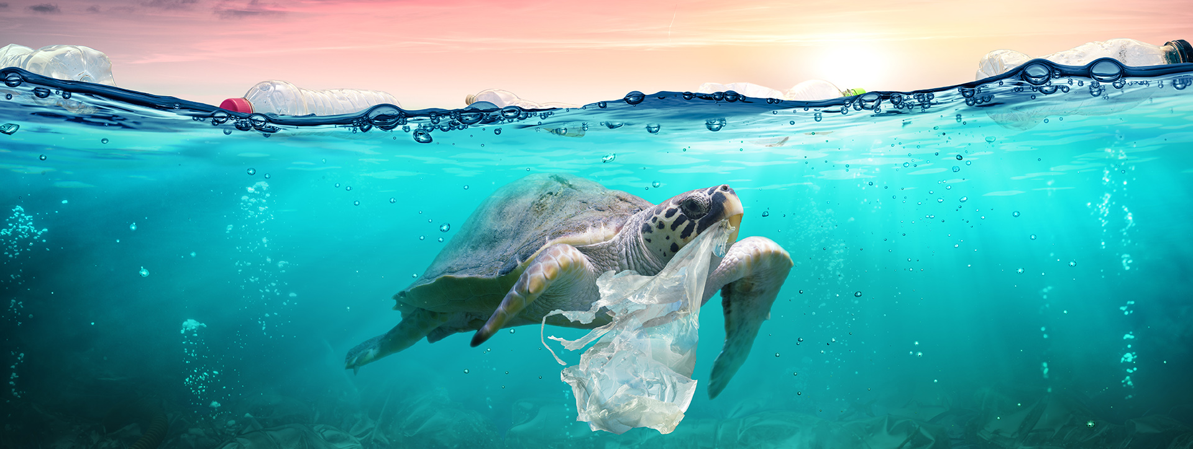
Rubbish can get tangled around the turtles or they can eat it and cause death.
This Photo by Unknown author is licensed under CC BY-ND.

Slide 3
Light pollution False light can confuse the baby turtles when they hatch and so they cant find the sea.
.

Slide 4
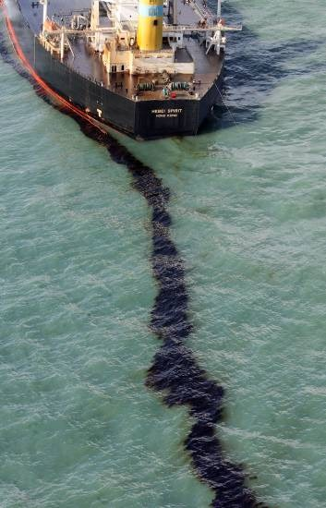
Oil can spill and cause harm to turtles .Also boats can hit turtles and kill them.
Oil and Boats
This Photo by Unknown author is licensed under CC BY-NC.

Slide 5
People on beaches are causing the turtles to have nowhere to lay there eggs.

