Slide 3
1) Complete the equivalent fraction:
2) Complete the equivalent fraction:
3) Complete the equivalent fraction:
$$\frac{\text{4}}{\text{10}}$$
$$\frac{\text{2}}{\text{5}}$$
$$=$$
$$\frac{\text{1}}{\text{3}}$$
$$\frac{\text{3}}{\text{9}}$$
$$=$$
$$\frac{\text{2}}{\text{3}}$$
$$\frac{\text{8}}{\text{12}}$$
$$=$$

Slide 4
1) Complete the equivalent fraction:
2) Complete the equivalent fraction:
3) Complete the equivalent fraction:
$$\frac{\text{4}}{\text{10}}$$
$$\frac{\text{2}}{\text{5}}$$
$$=$$
$$\frac{\text{1}}{\text{3}}$$
$$\frac{\text{3}}{\text{9}}$$
$$=$$
$$\frac{\text{2}}{\text{3}}$$
$$\frac{\text{8}}{\text{12}}$$
$$=$$

Slide 6
Can you imagine what these fractions look like?
$$\frac{\text{1}}{\text{2}}$$
$$\frac{\text{1}}{\text{4}}$$
$$\frac{\text{3}}{\text{5}}$$
$$\frac{\text{17}}{\text{25}}$$
$$\frac{\text{12}}{\text{48}}$$

Slide 7
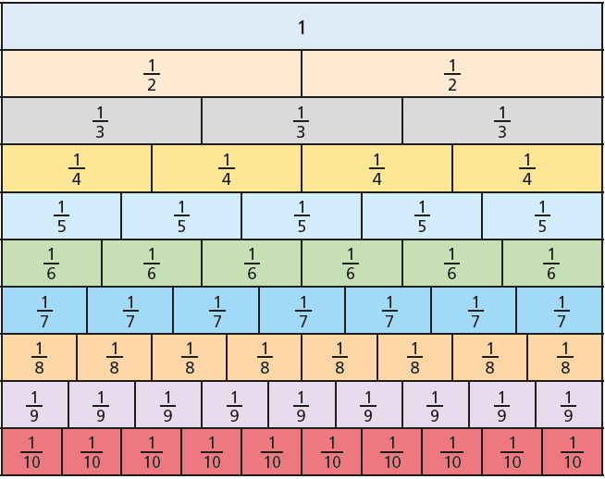

Slide 8
Use the fraction wall to simplify
Have a think
$$\frac{\text{5}}{\text{10}} \frac{\text{6}}{\text{10}} \frac{\text{5}}{\text{7}}$$
$$=\frac{\text{1}}{\text{2}}$$
$$=\frac{\text{3}}{\text{5}}$$

Slide 9
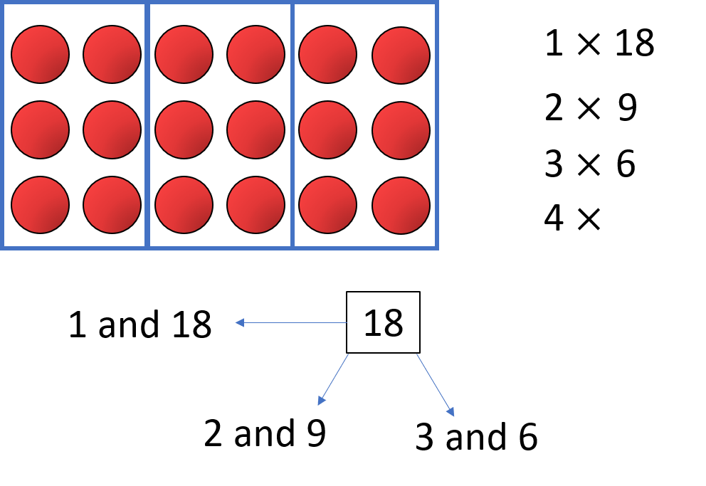
$÷$ 1
$$\frac{\text{5}}{\text{7}}$$
$$\frac{\text{5}}{\text{7}}$$
$$=$$
$÷$ 1
Factors of 5
Factors of 7
1
1
5
7

Slide 10
$\frac{\text{5}}{\text{7}}$ cannot be simplified any further
$\frac{\text{5}}{\text{7}}$ is in its simplest form

Slide 11
Have a go at questions 1 - 3 on the worksheet

Slide 12
$$\frac{\text{6}}{\text{9}}$$
$$\frac{\text{2}}{\text{3}}$$

Slide 13
$÷$ 3
$$\frac{\text{6}}{\text{9}}$$
$$\frac{\text{2}}{\text{3}}$$
$$=$$
$÷$ 3
Factors of 6: 1, 2, 3, 6
Factors of 9: 1, 3, 9

Slide 14
Have a think
Simplify the fraction using the bar models.
$\frac{\text{12}}{\text{16}}$ $=\frac{}{}$

Slide 15
Simplify the fraction using the bar models.
$\frac{\text{12}}{\text{16}}$ $=\frac{\text{6}}{\text{8}}$
$\frac{\text{12}}{\text{16}}$ $=\frac{}{}$

Slide 16
Simplify the fraction using the bar models.
$\frac{\text{12}}{\text{16}}$ $=\frac{}{}$
$\frac{\text{12}}{\text{16}}$ $=\frac{\text{6}}{\text{8}}$
$\frac{\text{6}}{\text{8}}$ $=\frac{\text{3}}{\text{4}}$

Slide 17
Simplify the fraction using the bar models.
$÷$ 4
Factors of 12: 1, 2, 3, 4, 6, 12
$\frac{\text{12}}{\text{16}}$ $=$
$$\frac{\text{3}}{\text{4}}$$
Factors of 16: 1, 2, 4, 8, 16
$÷$ 4

Slide 18
Tiny has been asked to simplify
$$\frac{\text{35}}{\text{40}}$$
$$\frac{\text{35}}{\text{40}}=\frac{\text{7}}{\text{10}}$$
Have a think

Slide 19
Tiny has been asked to simplify
$$\frac{\text{35}}{\text{40}}$$
$÷$ 5
$÷$ 5
$$\frac{\text{35}}{\text{40}}=\frac{\text{7}}{\text{10}}$$
$$\frac{\text{35}}{\text{40}}=\frac{}{}$$
$$\frac{\text{35}}{\text{40}}=\frac{\text{7}}{\text{8}}$$
$÷$ 4
$÷$ 5
Factors of 35: 1, 5, 7, 35
Factors of 40: 1, 2, 4, 5, 8, 10, 20, 40

Slide 20
Have a go at the rest of questions on the worksheet

