Slide 3
1) How many dots?
2) What is one more than 5?
3) What is one less than seven?
4) What number is missing? 2, 3, __ , 5

Slide 4
1) How many dots?
2) What is one more than 5?
3) What is one less than seven?
4) What number is missing? 2, 3, __ , 5
8
6
6
4

Slide 6
greater than
equal to
less than
6
5
is

Slide 7
greater than
equal to
less than
6
5
is

Slide 8
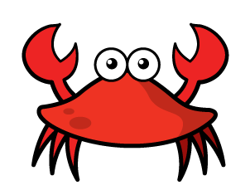
greater than
less than
Have a think
equal to
8
8
is

Slide 9
Have a go at question 1 on the worksheet

Slide 10
Let’s compare!
Rosie
Mo
Alex
7
5
6

Slide 11
Let’s compare!
Have a think
Rosie
Mo
Alex
7
5
6
Rosie has more than Alex because
7 is greater than 6

Slide 12
Let’s compare!
Have a think
Rosie
Mo
Alex
7
5
6
fewer than
Mo has Alex because
5 is 6
less than

Slide 13
Have a think
Rosie
Mo
Alex
7
5
6
fewer than
Mo has Rosie because
less than
5 is 7

Slide 14
Let’s compare!
Have a think
Rosie
Mo
Alex
6
6
5
6
7
Can they share and have the same?

Slide 15
Have a go at questions 2 and 3 on the worksheet

