Slide 3
What is represented here?
1)
2)
3)

Slide 4
What is represented here?
1) 5
2) 15
3) 15

Slide 6
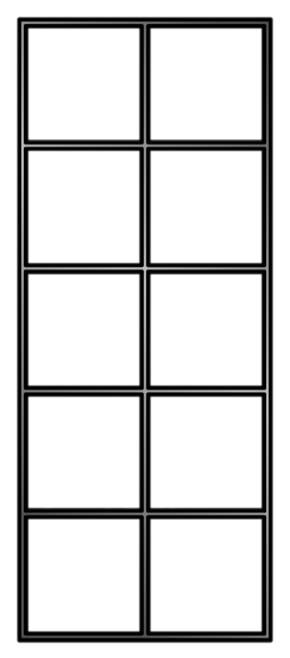
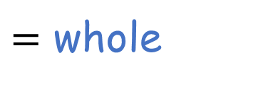
What is being represented here?
$=$ 6
7
$+$ 1
whole $=$
part
$$+$$
part
$+$ 6
$=$ 1
7
$+$ 1
$=$ 7
6
part
$$+$$
part
$=$ whole
$+$ 6
$=$ 7
1

Slide 7
What is being represented here?
Have a think
8
$$+$$
6
$$=$$
14
6
$$+$$
8
$$=$$
14
14
$$=$$
8
$$+$$
6
14
$$=$$
6
$$+$$
8

Slide 8
Have a go at question 1 on the worksheet

Slide 9
What is being represented here?
$−$ 1
7
$=$ 6
whole $−$
part
$$=$$
part
$=$ 1
$−$ 6
7
$=$ 7
$−$ 1
6
part
$=$ whole
$$−$$
part
$=$ 7
$−$ 6
1

Slide 10
8
$$+$$
6
$$=$$
14
part $+$ part $=$ whole
6
$$+$$
8
$$=$$
14
14
$$=$$
8
$$+$$
6
whole $=$ part $+$ part
14
$$=$$
6
$$+$$
8
14
$$−$$
8
$$=$$
6
whole $−$ part $=$ part
14
$$−$$
6
$$=$$
8
Have a think
6
$$=$$
14
$$−$$
8
part $=$ whole $−$ part
8
$$=$$
14
$$−$$
6

Slide 11
Have a think
3
$$+$$
6
$$=$$
9
3
$$+$$
9
$$=$$
6
9
$$−$$
3
$$=$$
6
part $+$ part $=$ whole
6
$$+$$
3
$$=$$
9
6
$$−$$
3
$$=$$
9
whole $−$ part $=$ part

Slide 12
Have a go at questions 2 and 3 on the worksheet

Slide 13
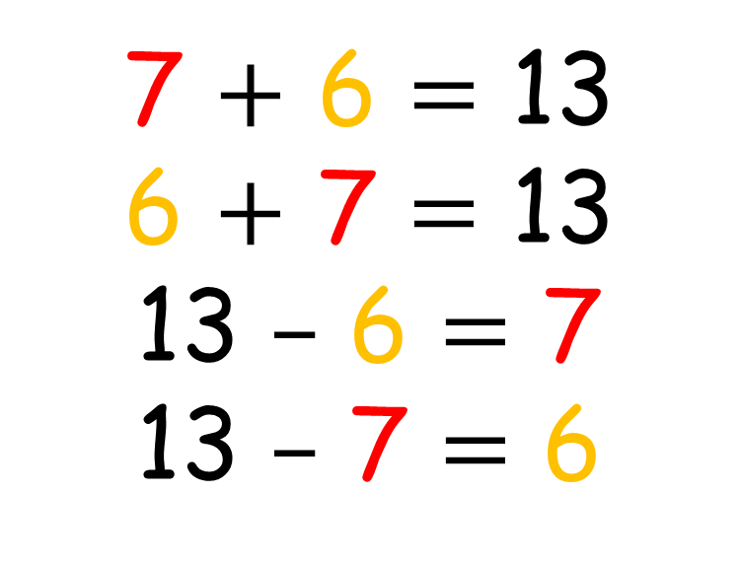
7 $+$ 6 $=$ 13
6 $+$ 7 $=$ 13
13 $–$ 6 $=$ 7
13 $–$ 7 $=$ 6
7
13
6

Slide 14
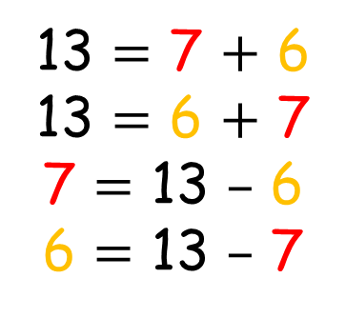
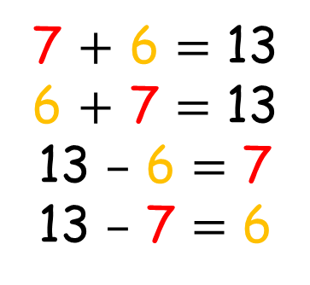
Have a think
7
7
13
13
7 $+$ 6 $=$ 13
6 $+$ 7 $=$ 13
13 $–$ 6 $=$ 7
13 $–$ 7 $=$ 6
13 $=$ 7 $+$ 6
13 $=$ 6 $+$ 7
7 $=$ 13 $–$ 6
6 $=$ 13 $–$ 7
6
6

Slide 15
Have a go at questions the rest of the worksheet

