Slide 3
1) What number is this? 7
2) Show me 4 using your fingers.
3) What number is this? “Five”
4) What number does this represent?

Slide 4
seven
1)
2)
3)
4)
1) What number is this? 7
2) Show me 4 using your fingers.
3) What number is this? “Five”
4) What number does this represent?
5
9

Slide 6
Let’s count backwards
ten
nine
eight
seven
six
five
four
three
two
one

Slide 7
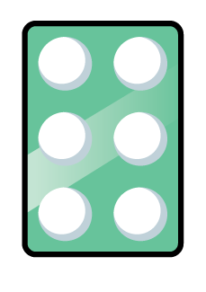
Count backwards on a number track
1 | 2 | 3 | 4 | 5 | 6 | 7 | 8 | 9 | 10
one | two | three | four | five | six | seven | eight | nine | ten

Slide 8
Have a think
Count backwards on a number track
1 | 2 | 3 | 4 | 5 | 6 | 7 | 8 | 9 | 10
What numbers are missing?

Slide 9
Have a think
Count backwards on a number track
 |  | 3 | 4 |  |  | 7 | 8 |  | 10
1 | 2 | 3 | 4 | 5 | 6 | 7 | 8 | 9 | 10
 |  | 3 | 4 |  |  | 7 | 8 | 9 | 10
 |  | 3 | 4 |  | 6 | 7 | 8 | 9 | 10
 |  | 3 | 4 | 5 | 6 | 7 | 8 | 9 | 10
 | 2 | 3 | 4 | 5 | 6 | 7 | 8 | 9 | 10
1 | 2 | 3 | 4 | 5 | 6 | 7 | 8 | 9 | 10
5
1
10
2
8
7
3
4
6
9
What numbers are missing?

Slide 10
Have a think
Count backwards on a number track
one |  |  | four | five | six |  | eight | nine | ten
one |  |  | four | five | six | seven | eight | nine | ten
one |  | three | four | five | six | seven | eight | nine | ten
one | two | three | four | five | six | seven | eight | nine | ten
eight
one
six
three
two
four
nine
five
seven
ten
What numbers are missing?

Slide 11
Have a go at questions 1 - 3 on the worksheet

Slide 12
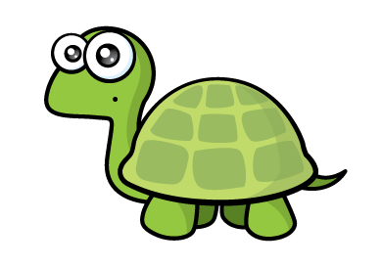
Count backwards from 10
Hey Tiny! I’m going to launch this toy rocket. Can you countdown from 10 to 1?
10, 9, 8, 6, 5, 4, 3, 2, 1… Blastoff!
What number did Tiny forget to say?
10, 9, 8, 7, 6, 5, 4, 3, 2, 1

Slide 13
Have a go at questions 4 and 5 on the worksheet

