Slide 3
To say these numbers should I count in 2s, 5s, or 10s?
15 40
45 55

Slide 4
To say these numbers should I count in 2s, 5s, or 10s?
15 40
45 55
2s or 10s
5s
5s
5s

Slide 6
Have a think
0 | 1 | 2 | 3 | 4 | 5 | 6 | 7 | 8 | 9 | 10 | 11 | 12 | 13 | 14 | 15 | 16 | 17 | 18 | 19

Slide 7
Have a think
0 | 1 | 2 | 3 | 4 | 5 | 6 | 7 | 8 | 9 | 10 | 11 | 12 | 13 | 14 | 15 | 16 | 17 | 18 | 19

Slide 8
1 | 2 | 3 | 4 | 5 | 6 | 7 | 8 | 9 | 10
11 | 12 | 13 | 14 | 15 | 16 | 17 | 18 | 19 | 20
21 | 22 | 23 | 24 | 25 | 26 | 27 | 28 | 29 | 30
31 | 32 | 33 | 34 | 35 | 36 | 37 | 38 | 39 | 40
41 | 42 | 43 | 44 | 45 | 46 | 47 | 48 | 49 | 50
Have a think

Slide 9
Have a go at questions 1 - 3 on the worksheet

Slide 10
0
3
6
9
12
15
even
odd
even
odd
even
odd
Have a think
0 | 1 | 2 | 3 | 4 | 5 | 6 | 7 | 8 | 9 | 10 | 11 | 12 | 13 | 14 | 15 | 16 | 17 | 18 | 19

Slide 11
Have a think
0 | 1 | 2 | 3 | 4 | 5 | 6 | 7 | 8 | 9 | 10 | 11 | 12 | 13 | 14 | 15 | 16 | 17 | 18 | 19

Slide 12
Have a think
0 | 1 | 2 | 3 | 4 | 5 | 6 | 7 | 8 | 9 | 10 | 11 | 12 | 13 | 14 | 15 | 16 | 17 | 18 | 19
even
odd
even
odd
even
odd

Slide 13
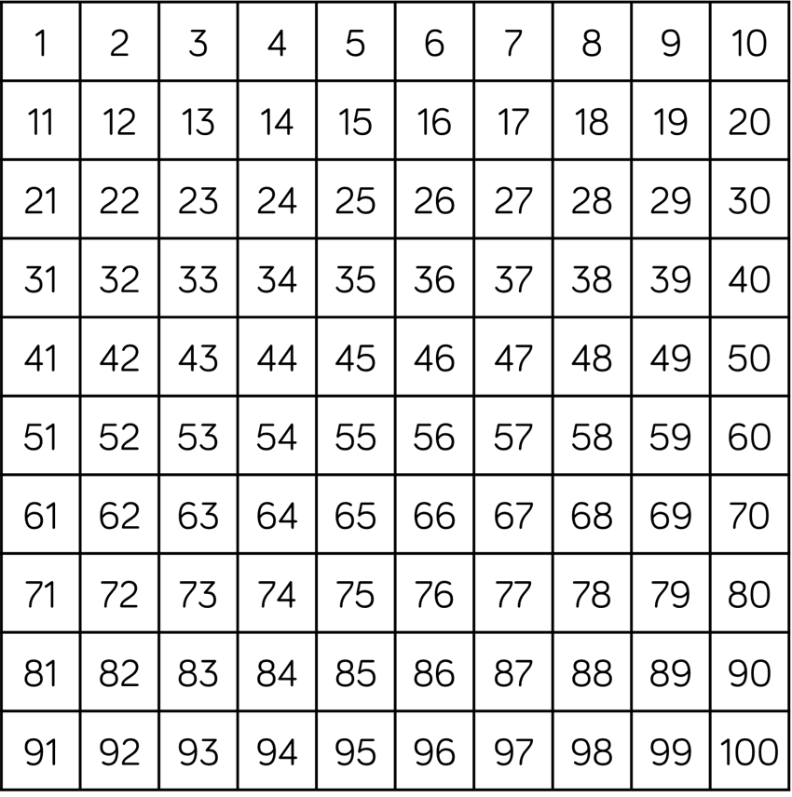
1 | 2 | 3 | 4 | 5 | 6 | 7 | 8 | 9 | 10
11 | 12 | 13 | 14 | 15 | 16 | 17 | 18 | 19 | 20
21 | 22 | 23 | 24 | 25 | 26 | 27 | 28 | 29 | 30
1 | 2 | 3 | 4 | 5 | 6 | 7 | 8 | 9 | 10
11 | 12 | 13 | 14 | 15 | 16 | 17 | 18 | 19 | 20
21 | 22 | 23 | 24 | 25 | 26 | 27 | 28 | 29 | 30
Have a think
1 | 2 | 3 | 4 | 5 | 6 | 7 | 8 | 9 | 10
11 | 12 | 13 | 14 | 15 | 16 | 17 | 18 | 19 | 20
21 | 22 | 23 | 24 | 25 | 26 | 27 | 28 | 29 | 30
Have a think

Slide 14
1 | 2 | 3 | 4 | 5 | 6 | 7 | 8 | 9 | 10
11 | 12 | 13 | 14 | 15 | 16 | 17 | 18 | 19 | 20
21 | 22 | 23 | 24 | 25 | 26 | 27 | 28 | 29 | 30

Slide 15
Have a go at the rest of the worksheet

