Slide 2
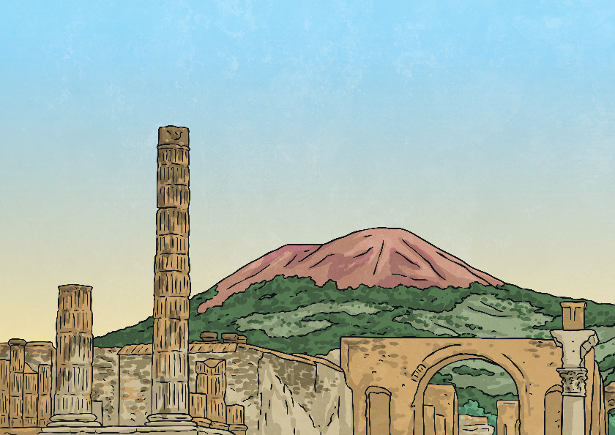
Mount Vesuvius
Mount Vesuvius erupted on 24th August AD 79 for the first time in hundreds of years. The consequences for the people who were living and working nearby were terrible.
Situated on the Gulf of Naples, in Italy, the eruption destroyed the neighbouring cities of Herculaneum and Pompeii, causing the death of thousands of people.
Pompeii was the larger of the two cities but both were filled with shops, houses and other buildings during the time of the Roman Empire.

Slide 3
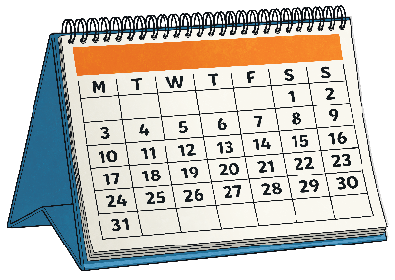
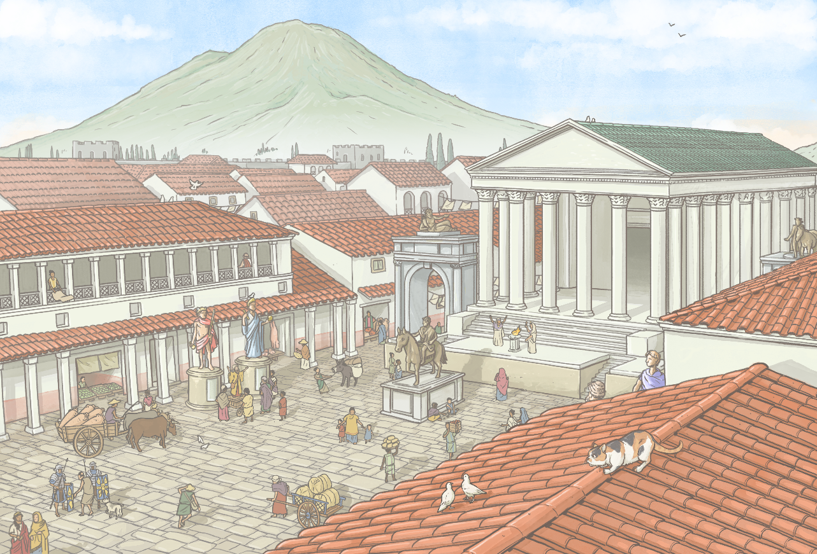
Days Before 24 August
AUGUST
th
Tremors were felt around the area of Mount Vesuvius but these were not considered completely unusual and many had been felt in the time leading up to the eruption.
Life in Pompeii continued as normal.

Slide 4
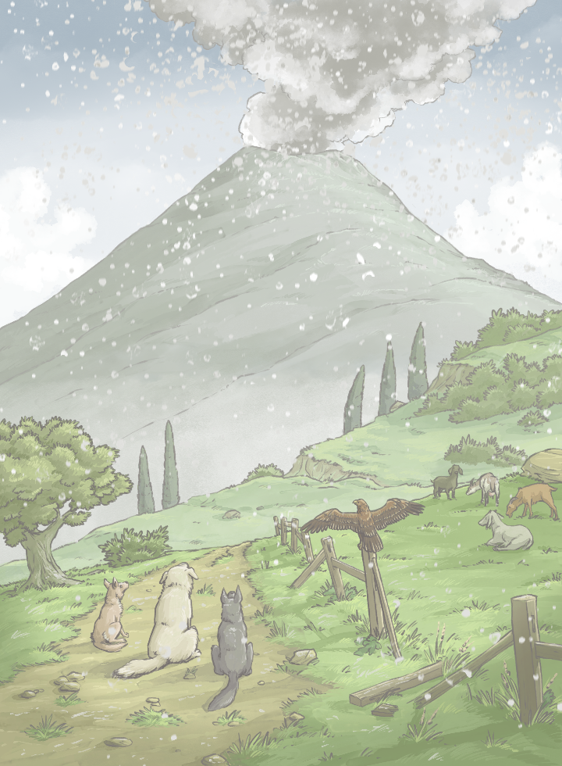
24th August
AUGUST
Morning
Mount Vesuvius’ first eruption phase began with a small explosion. A tremor was felt and thin ash cloud was sent into the sky.
It is thought that the feeling in Pompeii at this point was still relatively normal as tremors often happened near to the volcano.

Slide 5
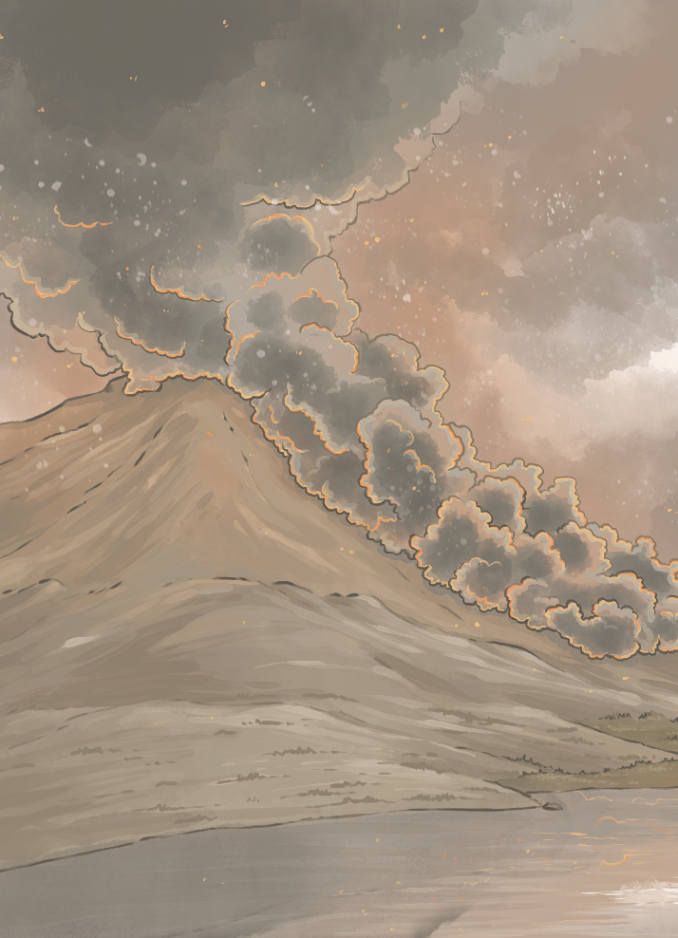
24th August
AUGUST
Early Afternoon (around 1 p.m.)
Vesuvius erupted violently.
A massive ash cloud was expelled up to 20km high, dominating the sky and blocking out the sun. The whole sky turned dark as the cloud was carried south-east and Pompeii was plunged into darkness.
Ash began to fall to the ground soon afterwards.

Slide 6
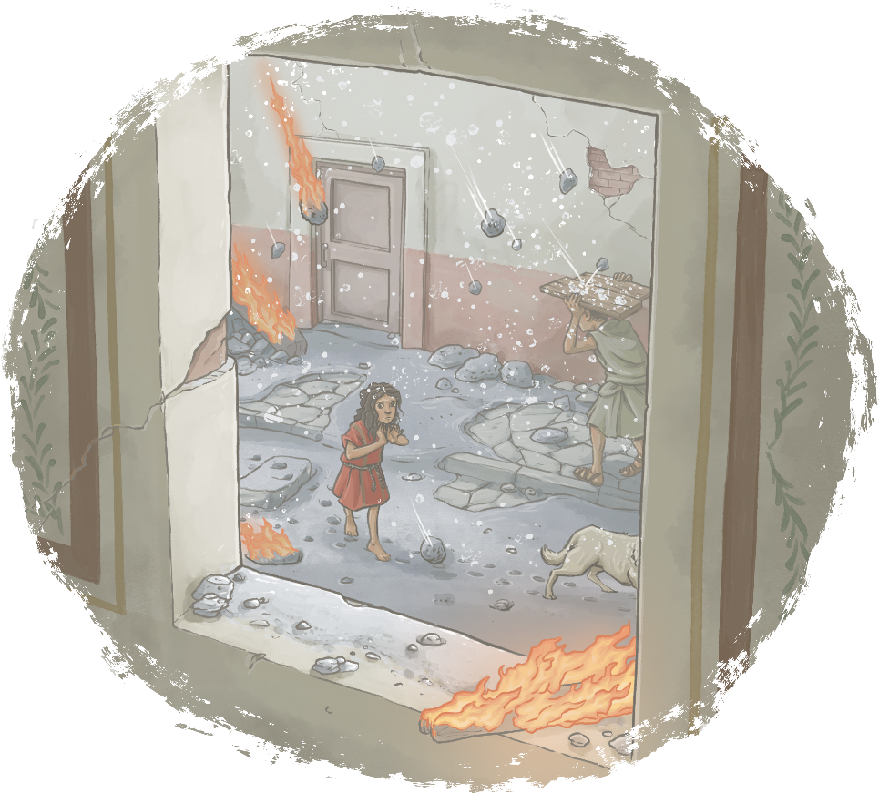
24th August
AUGUST
Afternoon (around 2 p.m.)
Ash and pumice was falling on Pompeii and panic had risen dramatically among the people of the city. Rocks and debris begin to land on buildings and build up on rooftops.

Slide 7
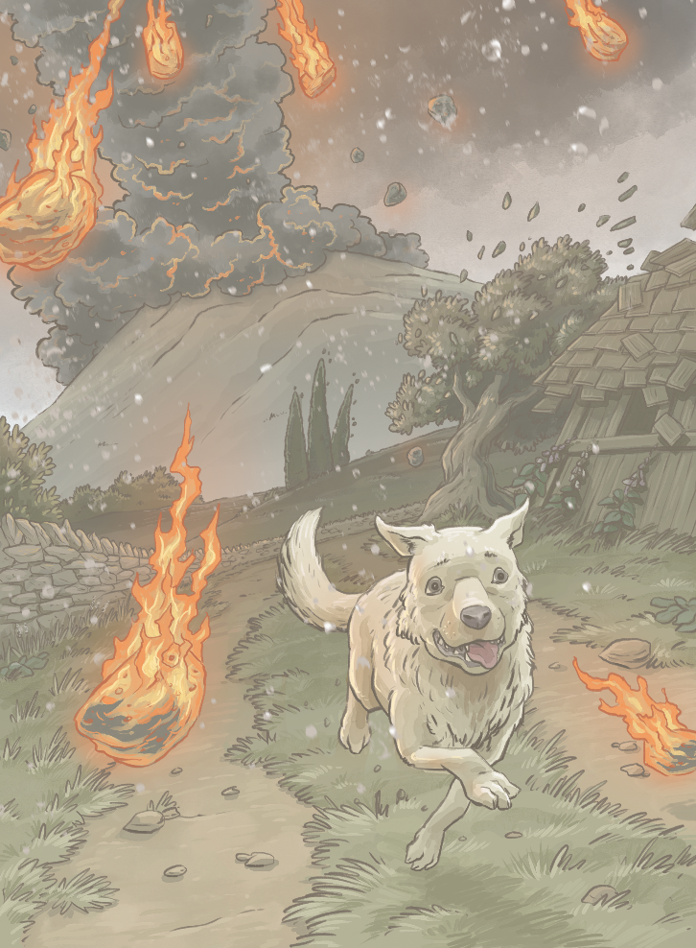
25th August
AUGUST
Midnight
The volcanic cloud reached its peak at the estimated height of over 30km in the air. This cloud began to plummet back down to earth.
A pyroclastic surge of extremely hot gas, rocks and volcanic material flowed with huge force and speed down the north-west side of the volcano into Herculaneum. Here, it killed many people.
It is thought that the pyroclastic surge travelled at an astonishing 350km per hour.

Slide 8
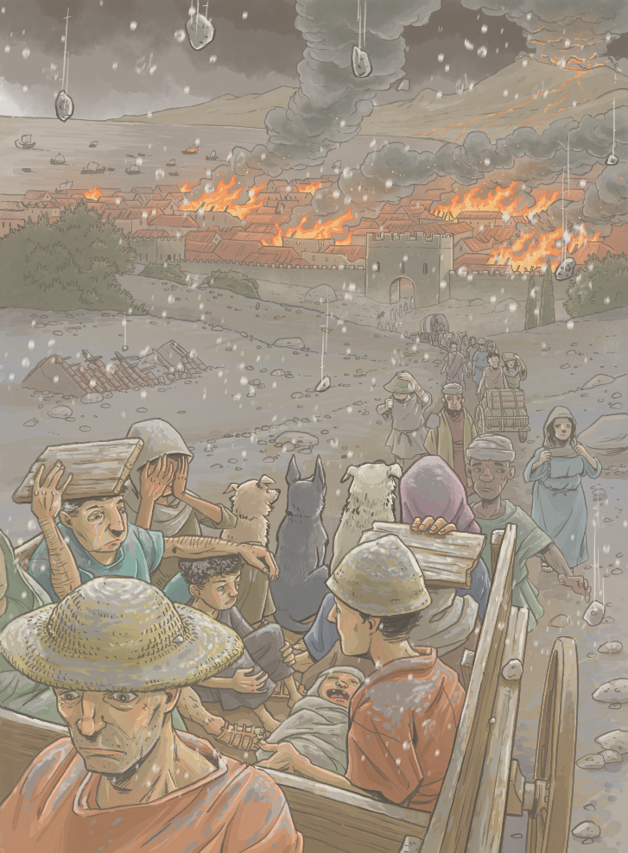
25th August
AUGUST
Early Morning (around 2 a.m.)
The eruption cloud collapsed once again.
Mount Vesuvius released a second pyroclastic surge, closely followed by a third surge, which was even stronger than the last.
The surge was growing ever closer to Pompeii.

Slide 9
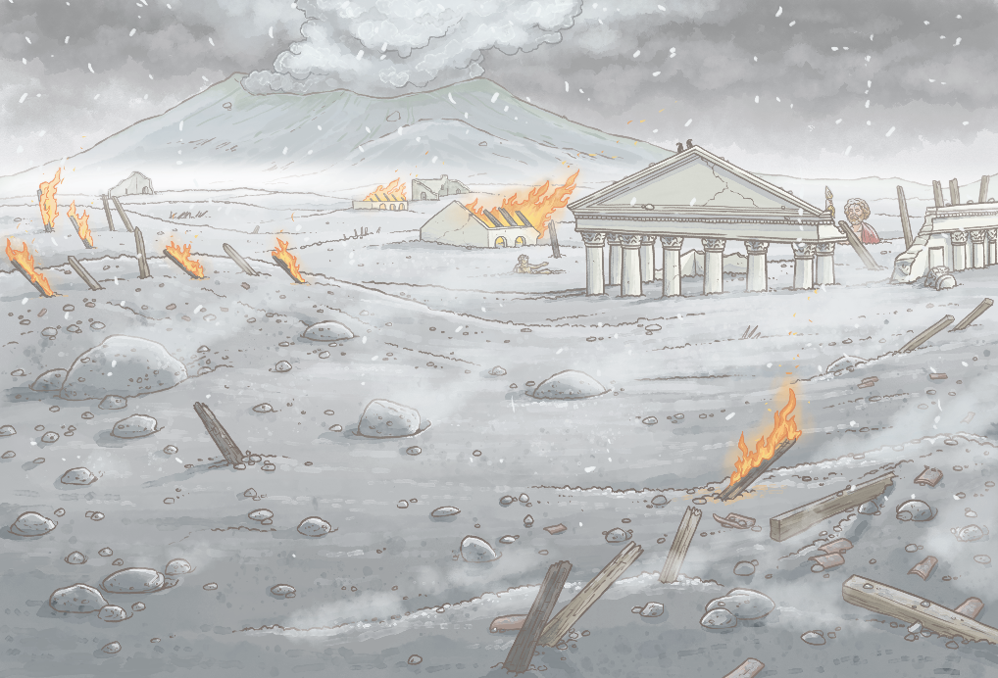
25th August
AUGUST
Morning (around 7 a.m.)
The cloud above Mount Vesuvius collapsed again.
A fourth surge of rock and gas was released and travelled with even greater force. It reached Pompeii and killed everyone remaining and destroyed any final buildings left standing.
Darkness still hung over the Bay of Naples due to the drifting ash cloud in the air.

Slide 10
25th August
AUGUST
Morning (around 8 a.m.)
Additional surges followed, bringing more rock, gas and debris down onto Pompeii. By the end of the entire eruption process, the city was buried under tonnes of volcanic material.

