Slide 1
Eva is performing a column subtraction with two four digit numbers.
The larger number has a digit total of 35
The smaller number has a digit total of 2
Use cards to help you find the numbers.
What could Eva’s subtraction be?
How many different options can you find?

Slide 2
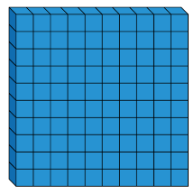
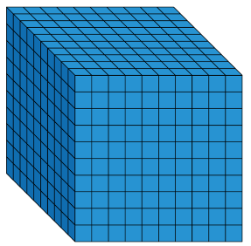
There are counters to the value of 3,470 on the table but some have been covered by the splat.
What is the total of the counters covered?
How many different ways can you make the missing total?

Slide 3
1,235 people go on a school trip.
There are 1,179 children and 27 teachers.
The rest are parents.
How many parents are there?
Explain your method to a friend.

Slide 4
Find the missing numbers that could go into the spaces.
Give reasons for your answers.
____ $−$ 1,345 $=$ 4__6
What is the greatest number that could go in the first space?
What is the smallest?
How many possible answers could you have?
What is the pattern between the numbers?
What method did you use?

Slide 5
Amir and Tommy solve a problem.
Amir
Tommy
Who is correct?
Explain your reasoning.
Why is one of the answers wrong?
When I subtract 546 from 3,232 my answer is 2,714
When I subtract 546 from 3,232 my answer is 2,686

Slide 6
There were 2,114 visitors to the museum on Saturday.
650 more people visited the museum on Saturday than on Sunday.
Altogether how many people visited the museum over the two days?
What do you need to do first to solve this problem?

Slide 7
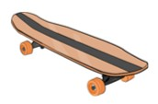
Amir has £1,000
He buys a scooter for £345 and a skateboard for £110
How much money does he have left?
Show 3 different methods of finding the answer.
Explain how you completed each one.
Which is the most effective method?

Slide 8
Here is a number sentence.
350 $+$ 278 $+$ 250
Add the numbers in different orders to find the answer.
Is one order of adding easier? Why?
Create a rule when adding more than one number of what to look for in a number.

Slide 9
In the number square below, each horizontal row and vertical column adds up to 1,200
Find the missing numbers.
Is there more than one option?
Check the rows and columns using the inverse and adding the numbers in different orders.
897
 |  | 832
 | 762

