Slide 3
1) Partition 72 into tens and ones.
2) What is 10 less than 50?
3) Subtract 10 from one hundred.

Slide 4
1) Partition 72 into tens and ones.
2) What is 10 less than 50?
3) Subtract 10 from one hundred.
72 $=$ 70 $+$ 2
40
90

Slide 6
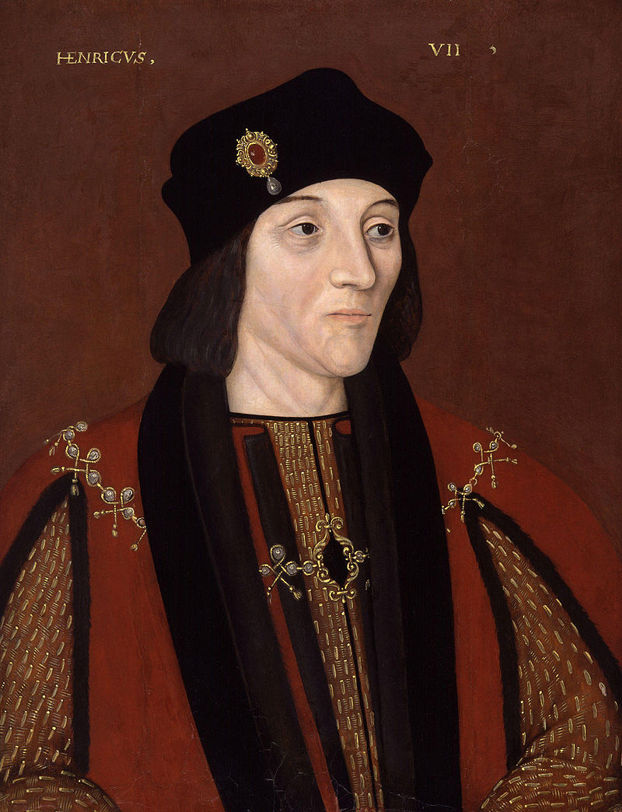
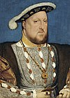
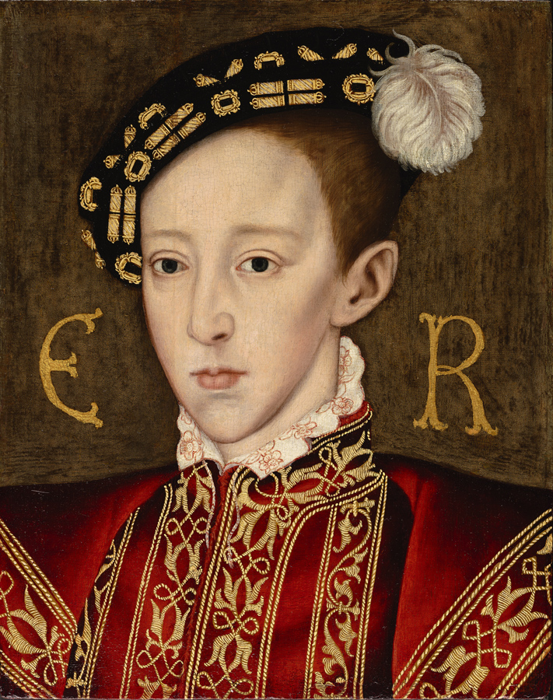
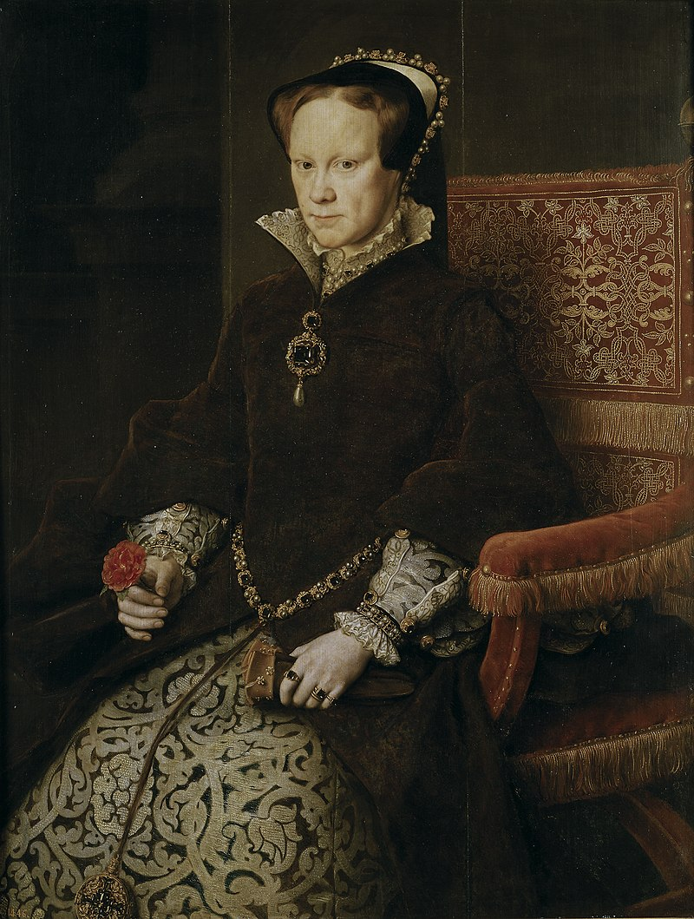
Henry VII
Henry VIII
Edward VI
Mary I
We’re learning about the monarchs in Tudor times.
The numbers look a bit different to how we say them.

Slide 7
Roman Numerals are written with a combination of symbols.
I $=$ 1
V $=$ 5
X $=$ 10
L $=$ 50
C $=$ 100
When a symbol is written after a larger or equal symbol it is added.
A maximum of three of the same symbol can be used in a number.
When a symbol is written before a larger symbol it is subtracted.

Slide 8
I
II
III
IV
V
VI
VII
VIII
IX
X
XI | XII | XIII | XIV | XV | XVI | XVII | XVIII | XIX | XX
I $=$ 1
V $=$ 5
X $=$ 10
L $=$ 50
C $=$ 100

Slide 9
Henry 7
Henry VII
Edward 6
Henry VIII
Edward VI
Henry 8
Mary 1
Mary I
So Henry VIII is Henry the 8th!
He’s the one who had 6 wives. That’s VI in Roman Numerals!

Slide 10
1 | 2 | 3 | 4 | 5 | 6 | 7 | 8 | 9 | 10
11 | 12 | 13 | 14 | 15 | 16 | 17 | 18 | 19 | 20
21 | 22 | 23 | 24 | 25 | 26 | 27 | 28 | 29 | 30
31 | 32 | 33 | 34 | 35 | 36 | 37 | 38 | 39 | 40
41 | 42 | 43 | 44 | 45 | 46 | 47 | 48 | 49 | 50
51 | 52 | 53 | 54 | 55 | 56 | 57 | 58 | 59 | 60
61 | 62 | 63 | 64 | 65 | 66 | 67 | 68 | 69 | 70
71 | 72 | 73 | 74 | 75 | 76 | 77 | 78 | 79 | 80
81 | 82 | 83 | 84 | 85 | 86 | 87 | 88 | 89 | 90
91 | 92 | 93 | 94 | 95 | 96 | 97 | 98 | 99 | 100
26 $=$
XX
VI
46 $=$
XL
VI
49 $=$
XL
IX
99 $=$
XC
IX

Slide 11
Have a go at questions 1 – 6 on the worksheet

Slide 12
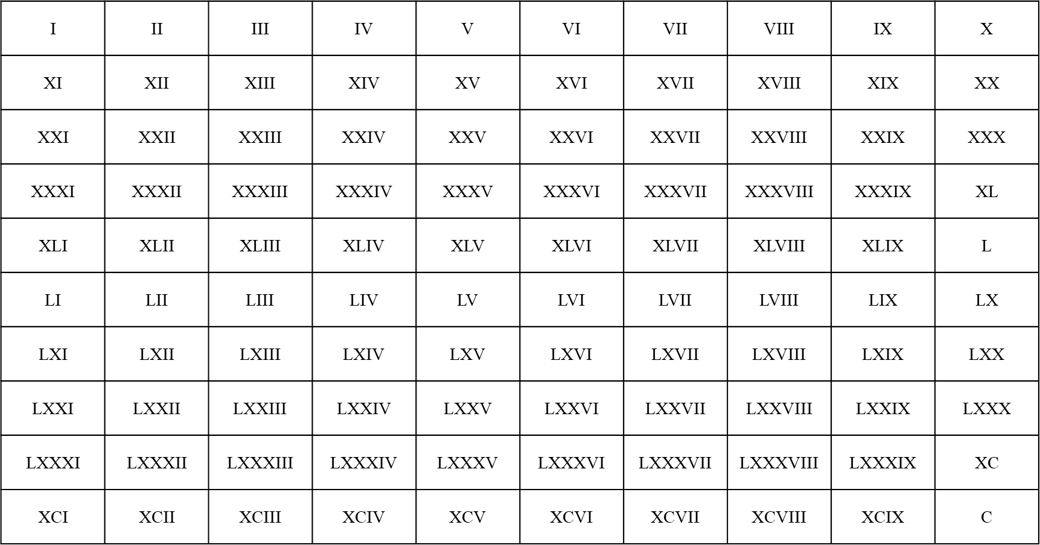

Slide 13
Have a go at the rest of the worksheet

