Slide 1
Year 2 - Autumn - Block 2
Addition & Subtraction

Slide 2
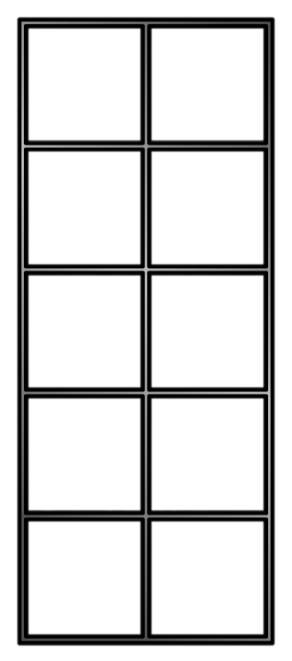
Here is an incomplete bar model.
The total is greater than 10 but less than 20
What could the missing numbers be?
How many different combinations can you find?
4

Slide 3
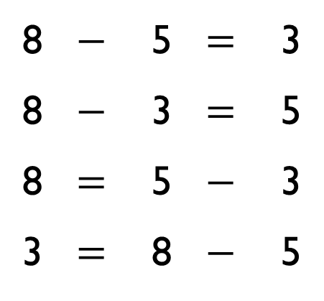
Rosie says,
Ron disagrees.
Who is correct? Can you prove it?
8 | $$−$$ | 5 | $$=$$ | 3
8 | $$−$$ | 3 | $$=$$ | 5
8 | $$=$$ | 5 | $$−$$ | 3
3 | $$=$$ | 8 | $$−$$ | 5
I think that all of these facts are correct because the numbers are related

Slide 4
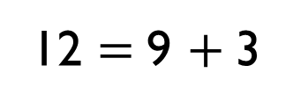
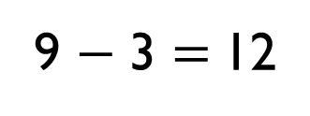
Which of the representations are equivalent to the bar model?
12
3 | 9
12 $=$ 9 $+$ 3
There are 9 cars in a car park, 3 cars leave.
9 − 3 $=$ 12
− 3

Slide 5
Eva did the following calculation:
12 $−$ 8 $=$ 4
She checked it by using the inverse.
She did 12 $+$ 8 $=$ 20 and said that her first calculation was wrong.
What advice would you give her?

Slide 6
Teddy is checking Dora’s work but doesn’t do an inverse calculation.
24 $+$ 6 $=$ 84
25 $−$ 23 $=$ 12
18 $−$ 3 $=$ 21
How might he know?
What errors have been made in each calculation?
These calculations can’t be right.

