Slide 1
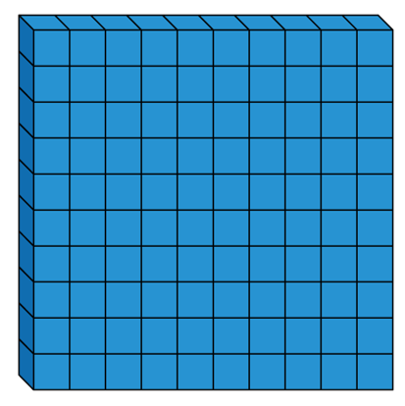
$+$ $=$ 800
Each of the missing numbers are multiples of 100
Find all the possible missing numbers.

Slide 2
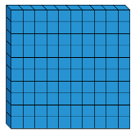
If I know 700 $−$ 500 $=$ 200, what else do I know?
Show me using concrete and pictorial representations.

Slide 3
Odd One Out
Which is the odd one out?
Explain why.
$+$
$+$
$+$

Slide 4
Rosie has added or subtracted ones to get this answer.
What could her calculation have been?
Her starting numbers are between and include 340 and 350
Did you use a strategy?
Do you see a pattern?
Hundreds | Tens | Ones

Slide 5
Which image does not represent
339 $–$ 8?
330
340

Slide 6
Alex thinks the chart shows 456 – 4
Do you agree?
Explain why.
Hundreds | Tens | Ones

