Slide 2
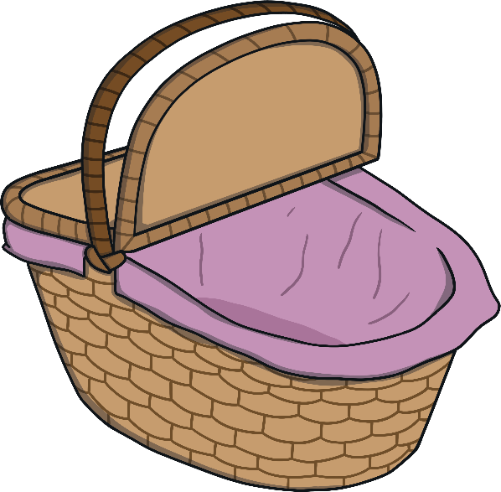
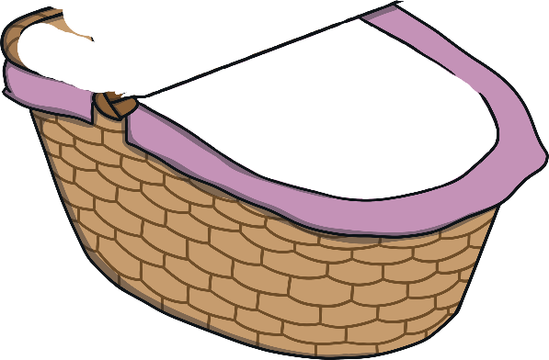
Meet Number Ten
Hello, I am Number Ten. What do you notice about me? What do I have 10 of? I’m off for lunch in the sun with my friend, Number One, and I need to take some sandwiches with me.
How many sandwiches did you count?

Slide 3
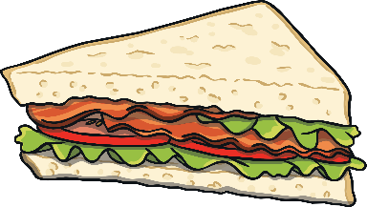
Meet Number One
Today, I am going to have lunch in the sun with my friend, Number Ten. We are going in a hot-air balloon! How many sandwiches do I have?
Hello, I am Number One. What do you notice about me? What do I have 1 of?

Slide 4
Number Ten and Number One arrived at the hot-air balloon park. They were excited to see each other and they both had a funny feeling. Then, there was a loud bang and…

Slide 5
…something magical happened!
I am Number Eleven.

Slide 6
Number Eleven looked at the hot-air balloons and decided which one to travel in. Which hot-air balloon do you think Number Eleven chose?
I chose this balloon. It has 11 spots.

Slide 7
Number Eleven saw a sign which said that he had to pay 11p to travel in the balloon.
Can you help me to work out which purse I need?
Let’s go in a hot-air balloon!
Try again.
11p

Slide 8
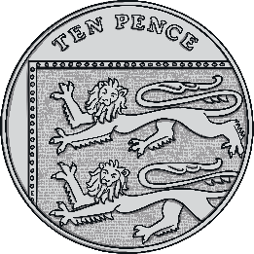
That’s right, there are 11 pennies in this purse. We can make 11p another way – click me to take a look. Talk about what you can see this time.

Slide 9
Number Eleven was suddenly very hungry. Time for lunch!
Can you remember how many sandwiches Number Ten packed? Click on the correct picnic basket.

Slide 10
Can you remember how many sandwiches Number One packed? Click on the correct ten-frame.

Slide 11
We make 11.
How many sandwiches do we have altogether?
Can you tell a partner? Click me to check.
I am 1.
I am one 10.

Slide 12
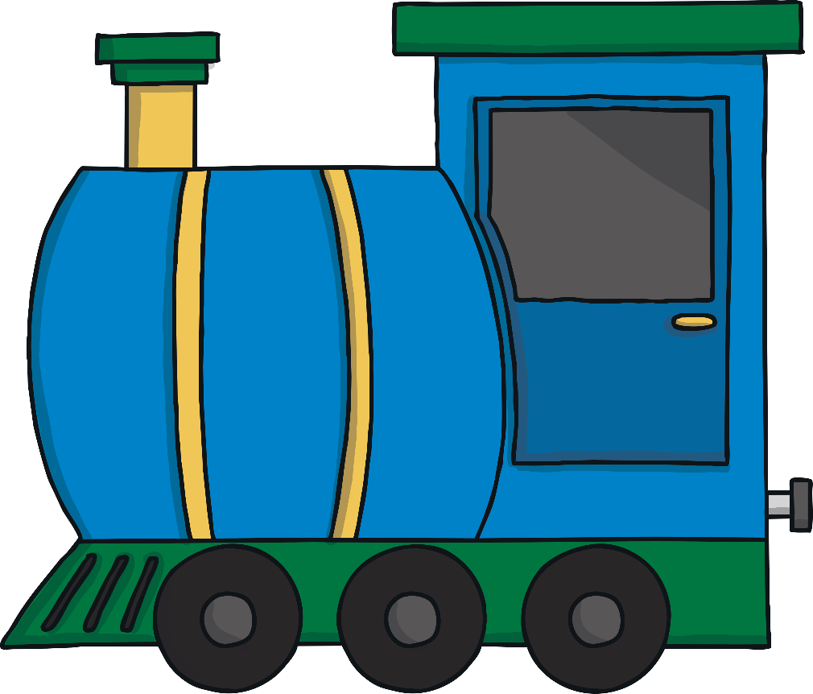
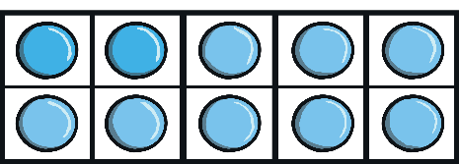
After lunch, Number Eleven looked down from the hot-air balloon and saw a train.
How many different ways is the number 11 shown?
What do you notice about the train?
How did you know it was the number 11 train?
eleven
11

Slide 13
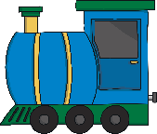
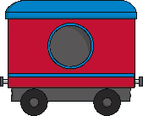
Number Eleven watched the train move along the track.
11
10
11
eleven
1
Try again.
Try again.
Try again.
Try again.
Try again.
Try again.
Try again.
Try again.
Try again.
Try again.
The carriages are numbered but some of the numbers are missing. Which carriage do you think would be number 11? Click it to check.

Slide 14
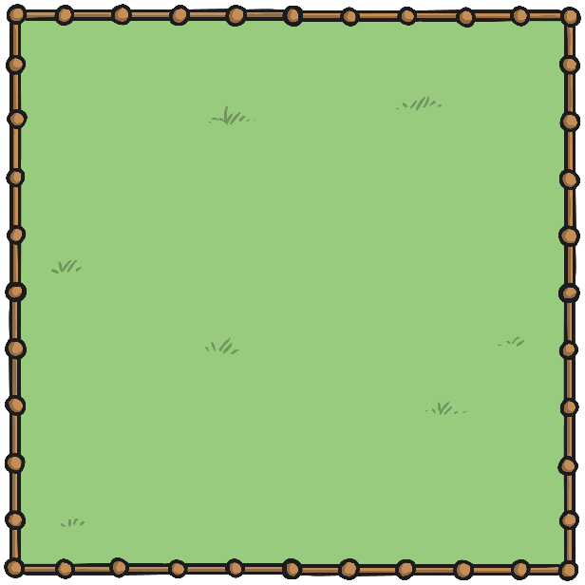
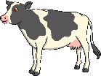
Up and up went the hot-air balloon. Number Eleven looked down on all the cows in the fields. I wonder which field has 11 cows. Can you help?
We can see 11 cows altogether.
I can see 1 cow.
I can see 10 cows.
Try again.

Slide 15
Up and up Number Eleven floated in his balloon. He saw the sun shining brightly in the sky. It had 11 rays. Can you click on the correct sun? How do you know that is the sun Number Eleven saw?
Yes! This picture shows 11 rays.
Try again.

Slide 16
Number Eleven saw some birds flying past the balloon.
How many birds are there altogether?
How many birds are in front of the yellow sun? How many birds are in front of the cloud?

Slide 17
We make 11.
I am 1.
I am one 10.

Slide 18
It was time for Number Eleven to go home. He started to have a funny feeling.

Slide 19
Suddenly, there was another loud bang!
What do you think is going to happen to me now?

Slide 20
Number Ten and Number One said goodbye to each other and made their way home.

Slide 21
Can you find 11 on the number track? Click on Number Eleven to move him onto the number track.
20
19
18
17
Which number comes before number 11? Which number comes after number 11? Can you spot any patterns when you look at the number track?
16
15
14
13
12
10

