Slide 3
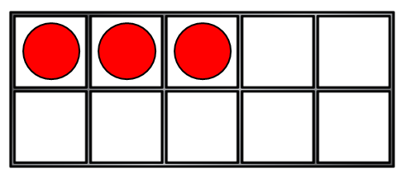
1) How many counters?
2) What number is missing? 4, 5, 6, __ , 8
3) How many pencils?
4) How do you spell 10?

Slide 4
1) How many counters?
2) What number is missing? 4, 5, 6, __ , 8
3) How many pencils?
4) How do you spell 10?
3
7
5
t-e-n

Slide 6
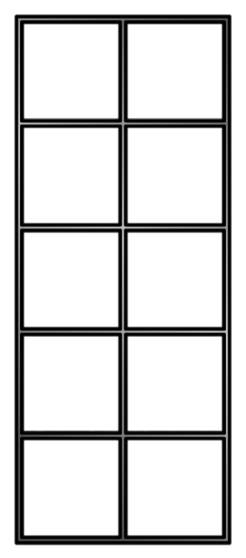
Count one more with ten frames
How many counters?
Count one more
One more than 5 is
6
One more than 8 is
9
One more than 2 is
3
One more than 4 is
5

Slide 7
Have a go at question 1 on the worksheet

Slide 8
Count one more with number tracks
1 | 2 | 3 | 4 | 5 | 6 | 7 | 8 | 9 | 10
One more than 8 is
9
One more than 1 is
2
6
One more than ___ is 7

Slide 9
Have a think
one | two | three | four | five | six | seven | eight | nine | ten
five
One more than 4 is .
8
One more than ___ is nine.
three
One more than 2 is .

Slide 10
Have a go at question 2 on the worksheet

Slide 11
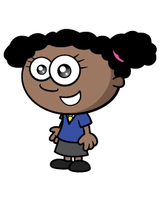
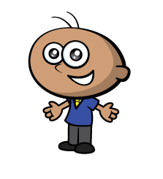
It’s our birthdays tomorrow!
Teddy is 4 today.
Tomorrow he will be .
5
9
Whitney is ___ today.
Tomorrow she will be ten.
1 | 2 | 3 | 4 | 5 | 6 | 7 | 8 | 9 | 10

Slide 12
Have a go at the rest of the questions on the worksheet

