Slide 1
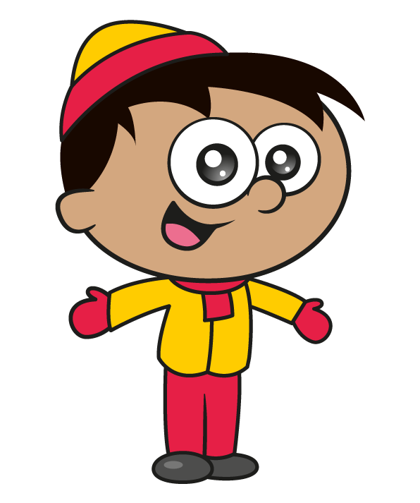
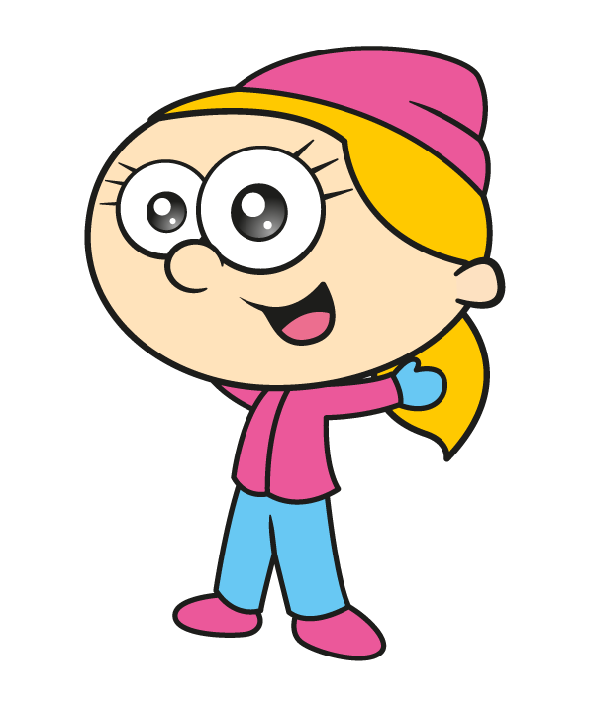
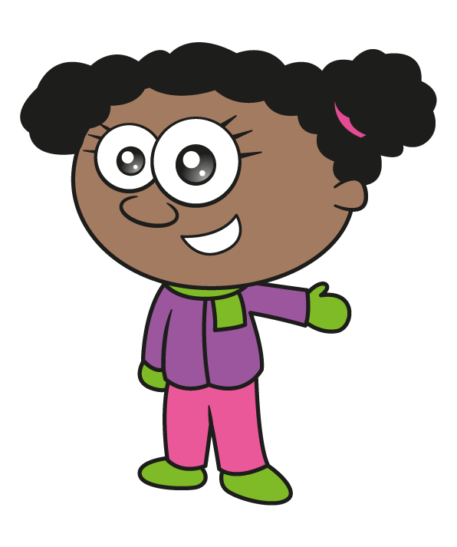

Slide 2
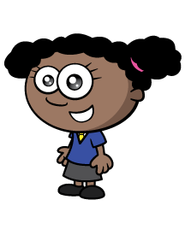
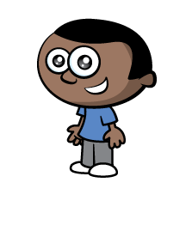
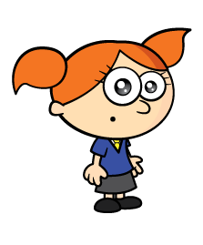
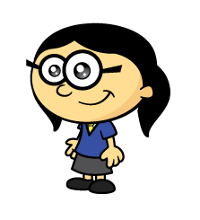
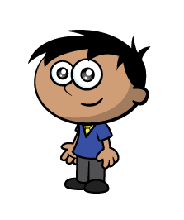
Socks come in pairs or twos.
How many individual socks will need washing if 8 children go on a winter walk?
How many if 10 children go?
How many if 15 children go?
How many if 20 children go?

Slide 3
0
2
4
6
8
10
12
14
16
18
20

Slide 4
Socks come in pairs or twos.
How many individual socks will need washing if 8 children go on a winter walk?
How many if 10 children go?
How many if 15 children go?
How many if 20 children go?
16
20
30
40

Slide 5
Can you make equal groups of 2?
Have a think

Slide 6
Can you make equal groups of 2?
Can you make equal groups of 3
or 5
or 7?
Groups of 4?
Groups of 6?
Groups of 8?
Groups of 10?

Slide 7
Mr Rose knits new scarf using
panels of 3 cm and panels of 5 cm.
The scarf measures 23 cm.
How many of each panel could he have used?
3 cm
5 cm
Have a think

Slide 8
23 cm
5 $+$ 5 $+$ 5 $+$ 5 $+$ 3
5 $+$ 3 $+$ 3 $+$ 3 $+$ 3 $+$ 3 $+$ 3

Slide 9
23 cm
5 $+$ 5 $+$ 5 $+$ 5 $+$ 3
5 $+$ 3 $+$ 3 $+$ 3 $+$ 3 $+$ 3 $+$ 3

Slide 10
23 cm
7 $+$ 1 $+$ 7 $+$ 1 $+$ 7
Are there any combinations which
make a nicer design?
What are their lengths?
5 $+$ 3 $+$ 1 $+$ 5 $+$ 1 $+$ 3 $+$ 5

