Slide 1
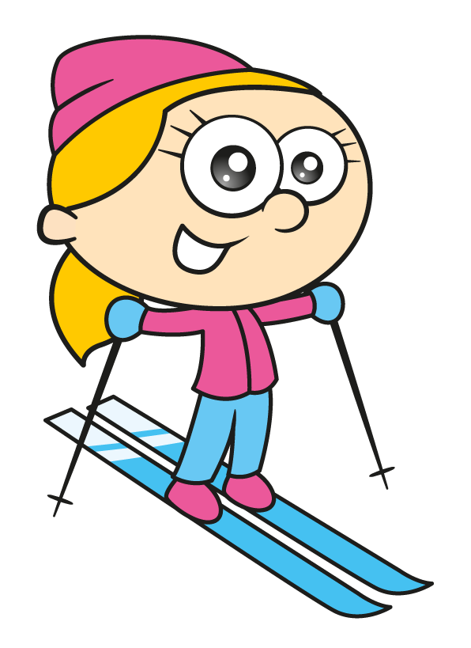
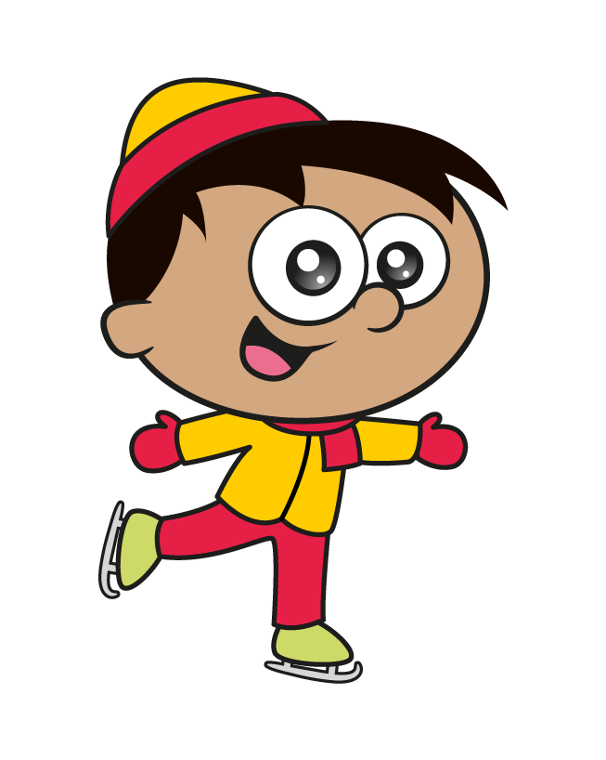
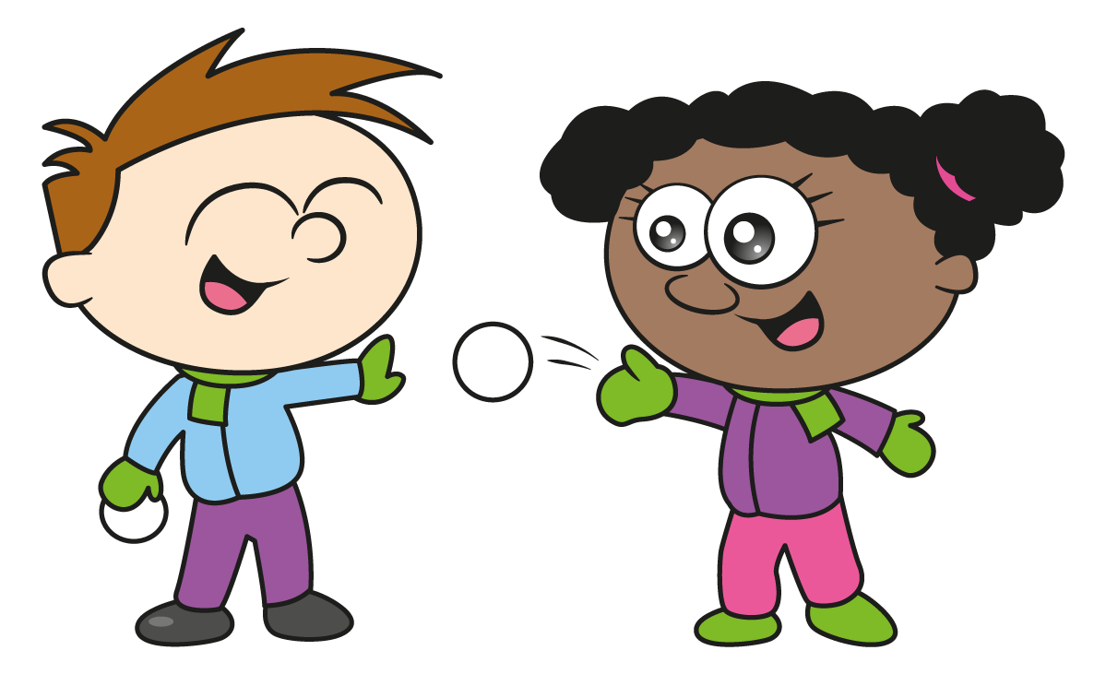
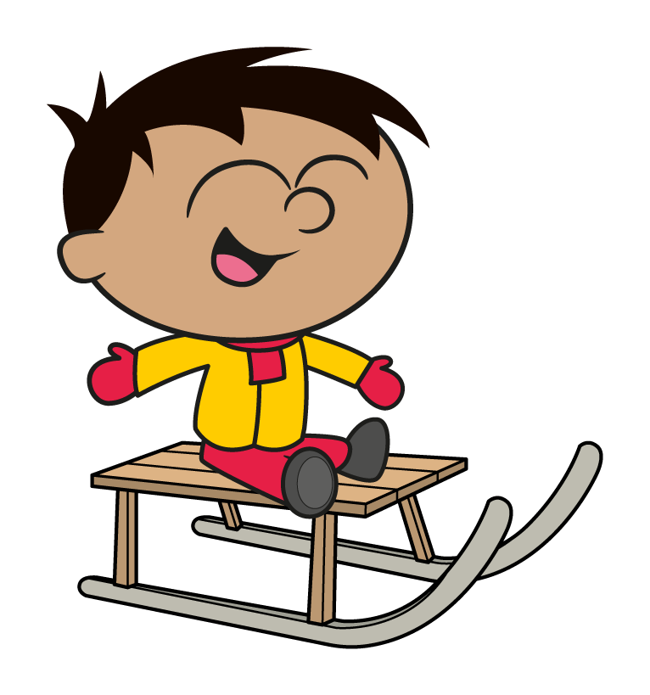

Slide 3
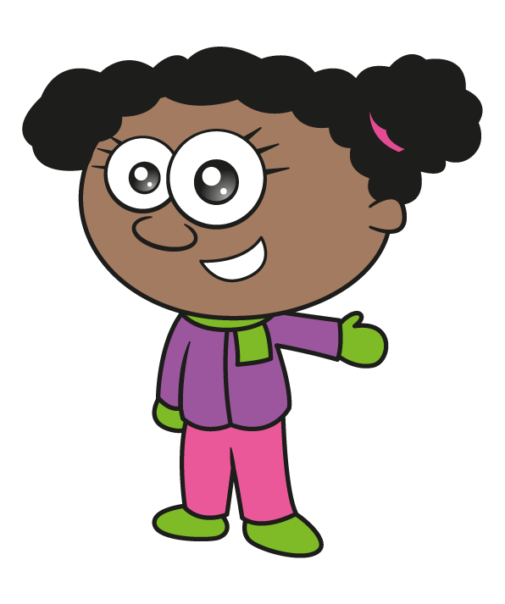
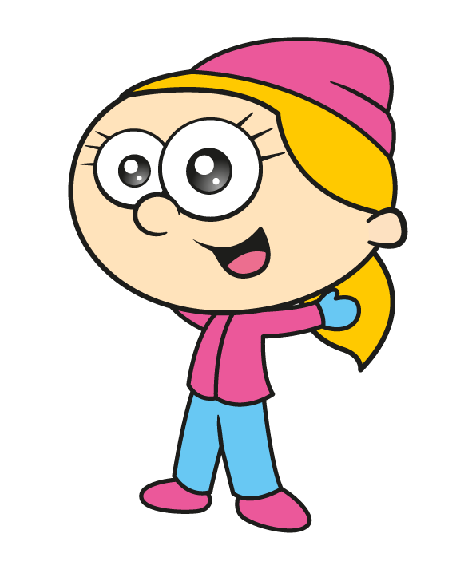
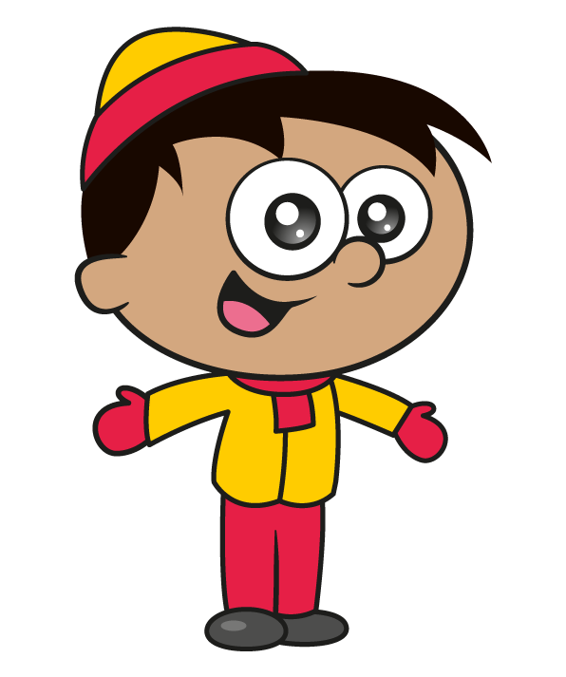
The children are playing a game.
Jack throws 3 snowballs and scores 50 points.
How could he do this? Is there more than one to score 50?
Have a think

Slide 4
Jack throws 3 snowballs and scores 50 points.
How could he do this? Is there more than one to score 50?
10
20
20
10
15
25
15
15
20

Slide 5
Whitney scores 30 points.
Eva throws 3 balls and scores more than Whitney but less than Jack. What could Eva’s score have been?
10
10
15
35
Have a think
10
10
20
40
10
15
15
40
10
15
20
45
10
10
25
45
30 $<$ $<$ 50

Slide 6
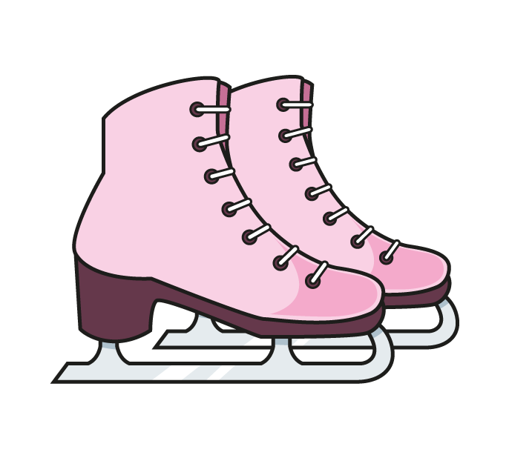
The children are taking part in an ice skating competition. What are their total scores?
Have a think
20
7
6
3
4
10
10
7
Double 7 $=$ 14
Bonds to 20

Slide 7
The children are taking part in an ice skating competition. What are their total scores?
Have a think
20
8
7
6
3
24
3 $×$ 7 $=$ 21
21 $+$ 3 $=$ 24

Slide 8
The children are taking part in an ice skating competition. What are their total scores?
Have a think
20
9
6
3
9
24
27
9

Slide 9
The children are taking part in an ice skating competition. What are their total scores?
Have a think
Can you place them in order to see who won?
20
9
5
8
4
24
13
27
13
26
Double 13 $=$ 26

Slide 10
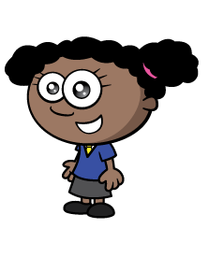
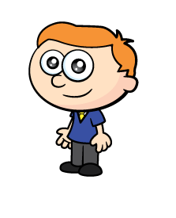
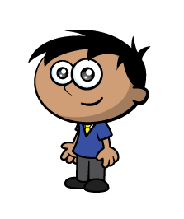
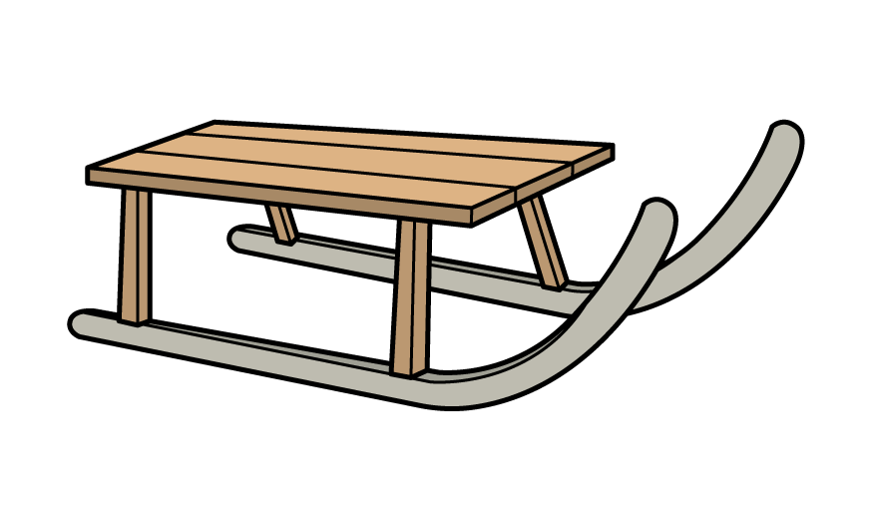
25 children are sledging.
They have 9 sledges between them.
Each sledge carries 2 or 3 children.
How many sledges carry 2 children?
How many carry 3 children?
Have a think

Slide 11
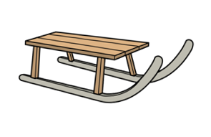
25 children are sledging.
They have 9 sledges between them.
Each sledge carries 2 or 3 children.
How many sledges carry 2 children?
How many carry 3 children?
2 sledges
7 sledges

Slide 12
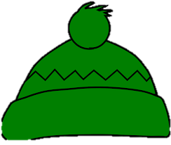
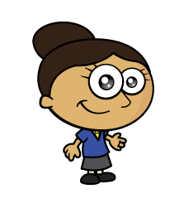
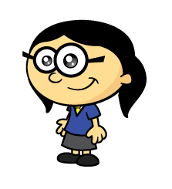
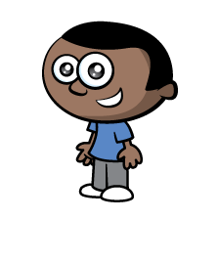
The children are playing a game.
They are arranging themselves in order so that
Between the 2 blue hats there is one hat.
Between the 2 green hats there are two hats.
Between the 2 black hats there are 3 hats.
Have a think

Slide 13
Between the 2 blue hats there is one hat.
Between the 2 green hats there are two hats.
Between the 2 black hats there are 3 hats.
What if 2 more children arrive wearing red hats and between them there are 4 hats?
Notes:
Solution – red, blue, black, blue, green red, black green

