Slide 3
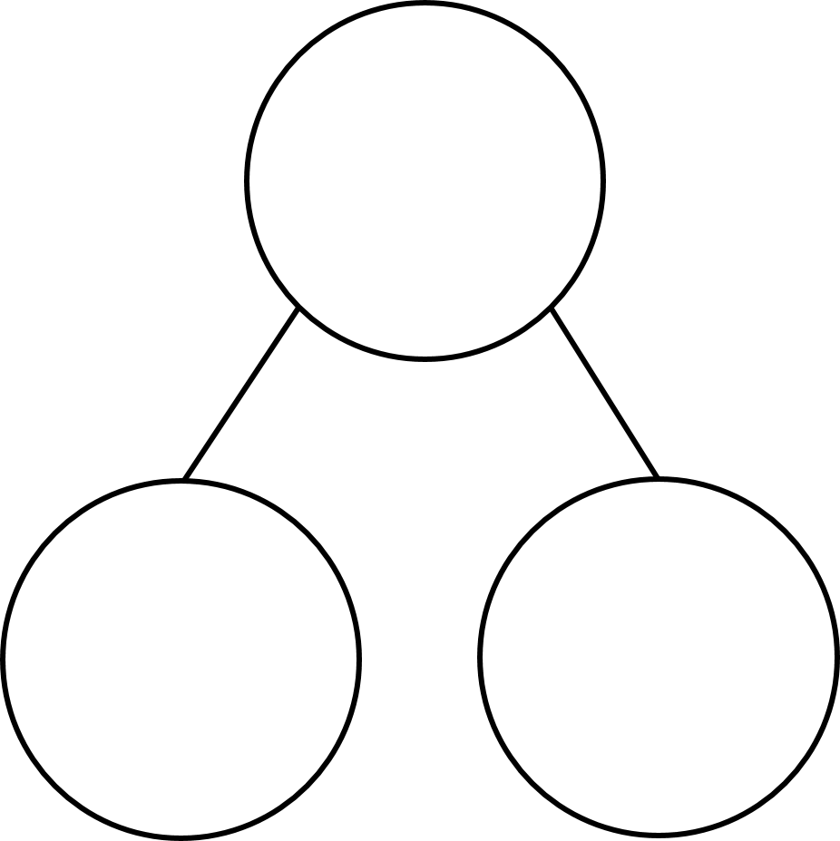
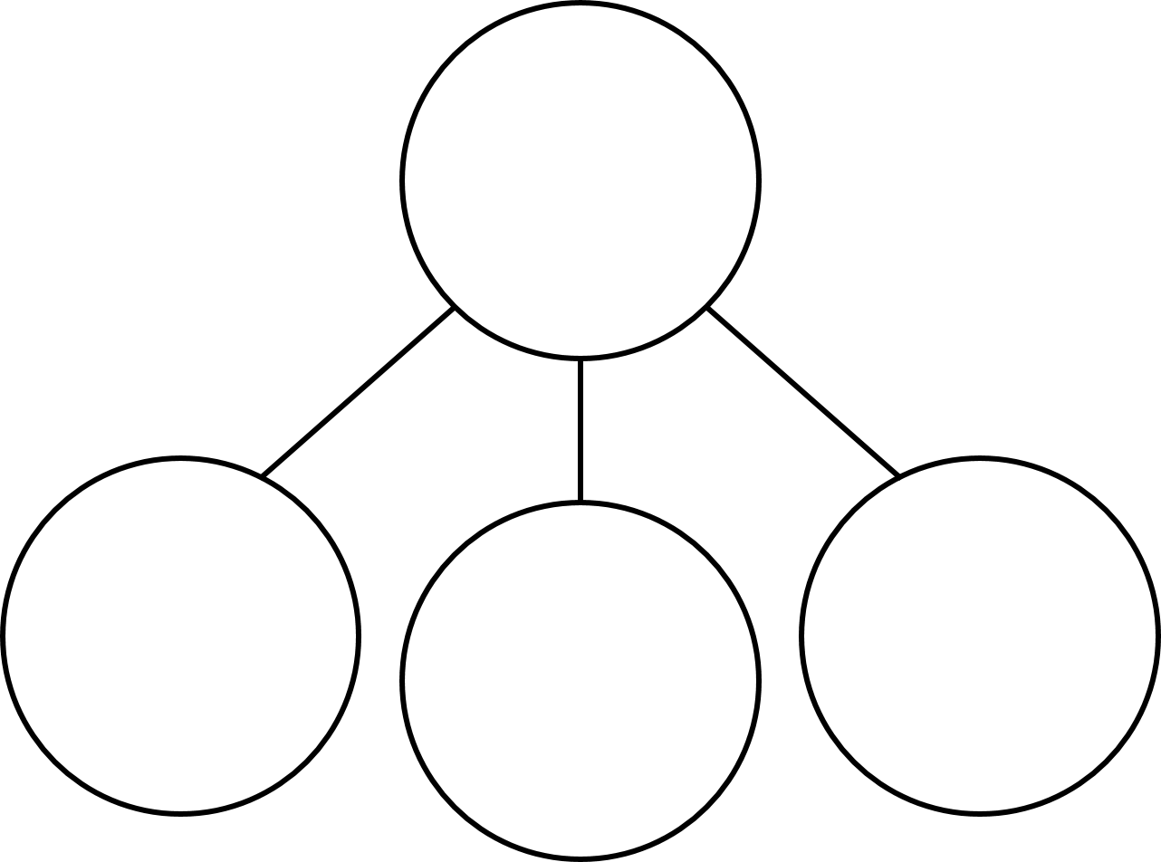
Complete the part-whole models
2)
3) 4)
3
10
6
4
3
1
2
5
3
8

Slide 4
Complete the part-whole models
2)
3) 4)
10
3
10
6
4
7
10
4
3
1
2
5
3
8

Slide 6
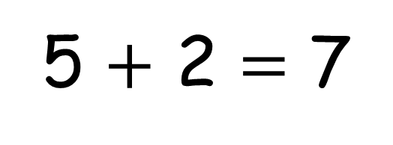
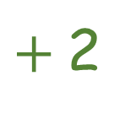
5 $+$ 2 $=$ 7
How many cupcakes has Ron baked in total?
$+$2
0
1
2
3
4
5
6
7
8
9
10

Slide 7
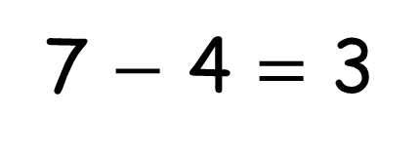
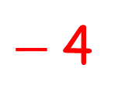
$−$4
0
1
2
3
4
5
6
7
8
9
10
7 $−$ 4 $=$ 3
Notes:
Ron gives 4 of his buns to his family.
How many buns does he have left?
This time we are going to need to subtract..
Let’s jump back 4 from 7
We are left with 3
7 minus 4 is equal to 3

Slide 8
How many cakes has Ron baked in total?
Notes:
Ron has been doing some more baking today!
Wow look at the number of buns he and his dad have baked
They have baked 25
Ron bakes 2 more
How many cakes has Rob baked now?

Slide 9
$+$2
20
21
22
23
24
25
26
27
28
29
30
25 $+$ 2 $=$ 27
Notes:
Let’s think of the problem using a number line again.
Can you think what our number line will go from and to this time.
Let’s start at 20 this time.

Slide 10
How many cupcakes has Ron baked in total?
Have a think
Notes:
Pause here and you have a go.
Ron has baked even more cakes this time. 35 I count.
He then bakes 2 more.

Slide 11
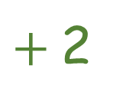
$+$2
\
30
31
32
33
34
35
36
37
38
39
40
Notes:
We have 35 and 2 more
Our number line this times starts at 30
We jump on 2 from 37
Do you notice a pattern here?
Each time we don’t have to worry about the tens.
All we do it add the ones and the tens are staying the same. We can just add the ones.

Slide 12
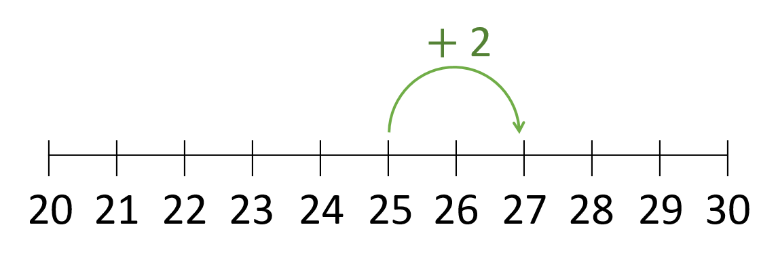
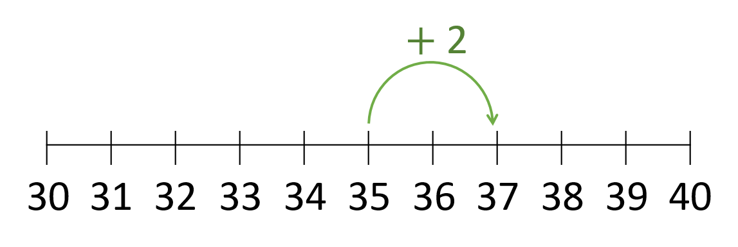
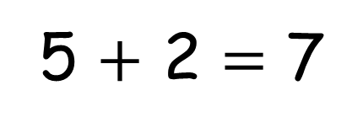
5 $+$ 2 $=$ 7
25 $+$ 2 $=$ 27
35 $+$ 2 $=$ 37

Slide 13
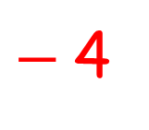
$−$4
20
21
22
23
24
25
26
27
28
29
30
27 $−$ 4 $=$ 23

Slide 14
Have a think
Ron baked 37 cupcakes. He gives 4 to his family.
How many does he have left?
Notes:
Remember the 37 cakes Ron baked.
Ron gives 4 to his family
How many does he have left
Pause here and have a go

Slide 15
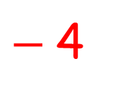
$−$4
30
31
32
33
34
35
36
37
38
39
40
37 $−$ 4 $=$ 33

Slide 16
Have a go at questions 1 - 3 on the worksheet

Slide 17
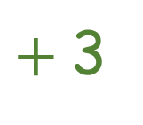
Work out 42 $+$ 3
42 $+$ 3 $=$ 45
$+$3
40
41
42
43
44
45
46
47
48
49
50
2 $+$ 3 $=$ 5
Notes:
Let’s have a go at working out 42 + 3 together.
Let’s make 42 using base 10
10, 20, 30, 40 41 42 and 3 more
Let’s use our number line to help us
We are starting and adding on 3

Slide 18
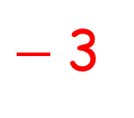
Work out 38 $−$ 3
$−$3
30
31
32
33
34
35
36
37
38
39
40
38 $−$ 3 $=$ 35
Notes:
Now let’s try 38 minus 3
Let’s make 38 in base 10.

Slide 19
Have a think
Have a go at these
53 $+$ 1 $=$ 54
56 $−$ 2 $=$ 54
54 $+$ 2 $= \text{5}$6
57 $−$ 4 $=\text{5}$3
56 $+$ 3 $= \text{5}$9
54$−$ 3 $=$ 51
50
51
52
53
54
55
56
57
58
59
60
Notes:
Why don’t you Pause the video here and have a go at these, before you have a go at the Worksheet

Slide 20
Have a go at the rest of the worksheet

