Slide 1
Year 3 - Autumn - Block 2
Addition & Subtraction

Slide 2
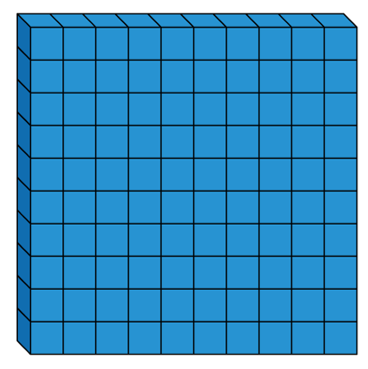
$+$ $=$ 800
Each of the missing numbers are multiples of 100
Find all the possible missing numbers.

Slide 3
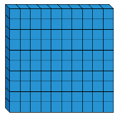
If I know 700 $−$ 500 $=$ 200, what else do I know?
Show me using concrete and pictorial representations.

Slide 4
Odd One Out
Which is the odd one out?
Explain why.
$+$
$+$
$+$

Slide 5
Rosie has added or subtracted ones to get this answer.
What could her calculation have been?
Her starting numbers are between and include 340 and 350
Did you use a strategy?
Do you see a pattern?
Hundreds | Tens | Ones

Slide 6
Which image does not represent
339 $–$ 8?
330
340

Slide 7
Alex thinks the chart shows 456 – 4
Do you agree?
Explain why.
Hundreds | Tens | Ones

Slide 8
Always, Sometimes, Never
When 7 and 5 are added together in the ones column, the digit in the ones column of the answer will always be 2
What other digits would always give a 2 in the ones column? Prove it.

