Slide 1
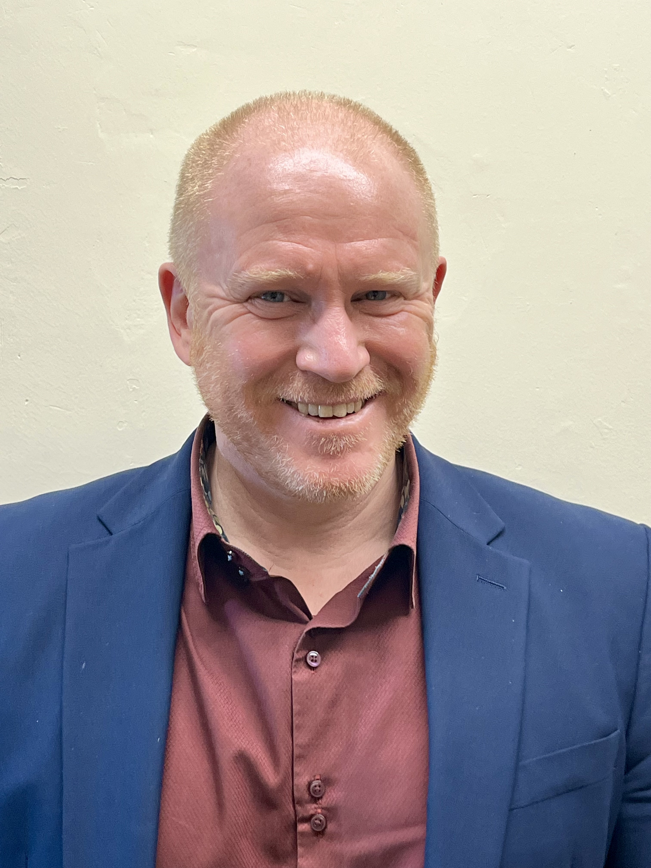
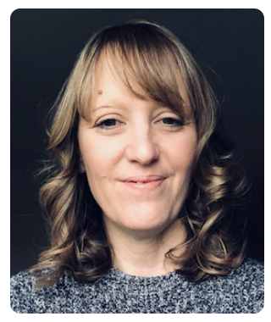
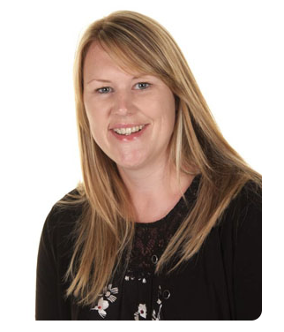
Meet the Team
Pam Acheson
Katie Barker
Andy Scott

Slide 2
Pam Acheson
I qualified as a teacher from the College of Ripon and York St John in 1997 with a Theology degree and have since worked for three different local authorities. I started my career at Corporation Road Primary in Darlington. After taking some time out to travel round Australia, I then worked at Cathedral Primary School in Ripon where I was lucky enough to have taught in every year group from Reception to Y6 and was a subject leader for a range of core and foundation subjects. I have also worked for Hartlepool Borough Council as a teacher before returning to North Yorkshire working as an Assistant Headteacher at Cathedral Primary for 3 years. I took up my first Headship in 2015 at Scotton Lingerfield Primary School and then moved to the Federation of Grewelthorpe and Fountains CE Primary Schools in January 2019. I am the Designated Safeguarding Lead for the Federation and am also responsible for leading RE, Collective Worship and Modern Foreign Languages.

Slide 3
Katie Barker I first began working at Fountains School in 2007 as a Teaching Assistant before leaving to complete a PGCE. I then began my teaching career at Fountains in 2009 in Year 3 & 4 before I moved into Year 5 & 6 in 2010 where I have taught ever since. I was given the role of Interim Headteacher for the Autumn term 2018 to see the Federation through the short transition period to the arrival of our now Headteacher, Pam Acheson. In January 2019, I resumed teaching in Year 5 & 6 and also took on the role of Assistant to the Head at Fountains. More recently I have taken on the role of Deputy Headteacher across the Federation. I currently lead English across the Federation, the Deputy Designated Safeguarding Lead and am responsible for teaching and learning as part of my Senior Leadership position. I joined the Governing Body of Fountains School in 2013 as the Staff Governor and also worked as the pupil premium Governor. I was then part of the working party that steered the school through the transformation into a Federation with Grewelthorpe Primary. When the two schools were federated in 2015, I remained on the Governing Body and I’m currently the Staff Governor.

Slide 4
Andy Scott I was working as an archaeologist when, in 2008, I decided to change career to primary teaching. I have a degree and master's degree in archaeology from UCL and the University of York, and a post graduate certificate in primary education (PGCE) from Leeds Beckett University. ​ After completing my training, I worked in a number of different schools in the Bradford, before moving to North Yorkshire, joining the Upper Wharfedale Primary Federation of four schools situated above Skipton. My first post was at Kettlewell Primary School, and after three years I moved to Grassington. I have taught across the key stages, but predominantly in KS2. I was the Base Leader at Grassington Primary School, Designated Safeguarding Lead, English Lead, and Assistant Headteacher for the federation. ​ I have been working at Fountains and Grewelthorpe schools as Deputy Headteacher since Easter, covering Mrs Barker's maternity leave. On her return in 2024, I will remain with the federation as part of the senior leadership team (SLT).​

Slide 5
Teamwork

Slide 6
Expectations
Clarify our roles and expectations – that we are all leaders, working together as a team towards our desired goal; collaborating across all three schools to share best practice and teacher workload.
Identify strengths and areas for development across the schools.
Agree actions which will move all three schools forward on their school development journeys– providing training (staff and governor development) - identifying key milestones when these actions can be reviewed.
Maintain the unique identity of each individual school.
Establish positive working relationships with all stakeholders.
Establish clear channels for communication.
Create a positive ethos, empowering staff to be confident teachers and leaders of their subjects through collaboration and a development of pedagogy to ensure consistently good quality first teaching.
Continue to develop the curriculum so that all subjects are knowledge and vocabulary rich; building on existing knowledge and skills; deepening their understanding and application of knowledge and skills; providing meaningful enrichment experiences.
Established a ‘growth mindset’ culture of learning.
Happy school family where everyone feels listened to, involved, valued and most importantly…feels successful!

Slide 7
If you have any questions please use the email address below. Pam Acheson: Headteacher Grewelthorpe and Fountains CofE Primary Schools headteacher@gfschools.co.uk

