Slide 2
Families from Around the World Teachers’ Notes
Across the world, children are growing up in many kinds of families, with diverse experiences of accommodation, food, cultural expectations and traditions. Some families have had to flee their homes due to conflict and war.
This PowerPoint, aimed at a young learners audience, presents simple information about typical families from cultures across the world.
It is intended to raise all children’s awareness of differing family values and experiences in order to prompt discussion.
Please remind children to be aware that such examples may contain generalisations and oversimplification and as a result, are not representative of all families from any given country or culture.

Slide 3
Introduction
What?
Who?
Where?
Family
Why are families important?
How do families eat?
Are all families the same?

Slide 4
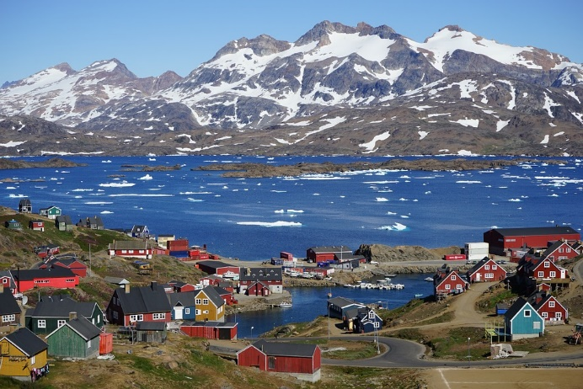
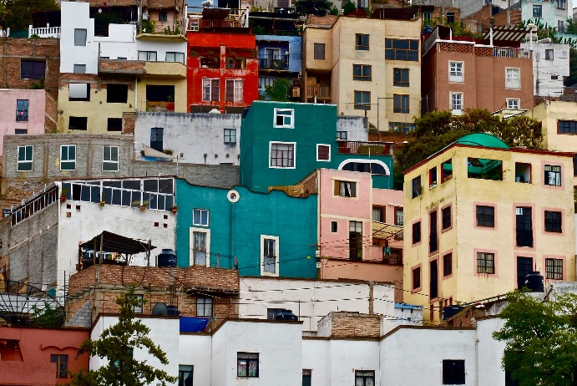
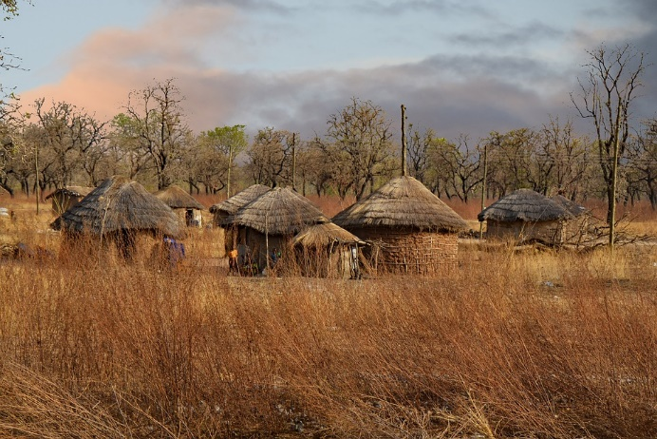
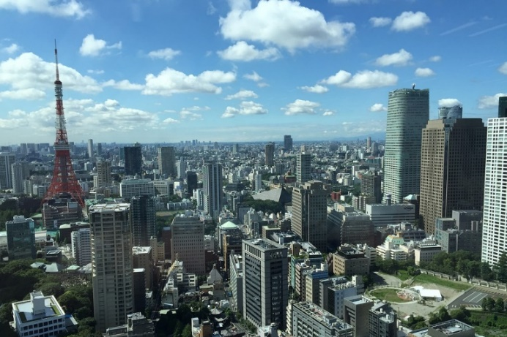
Homes from Around the World
“Title of Image Used” by [Wikimedia.org] is licensed under CC BY 2.0

Slide 5
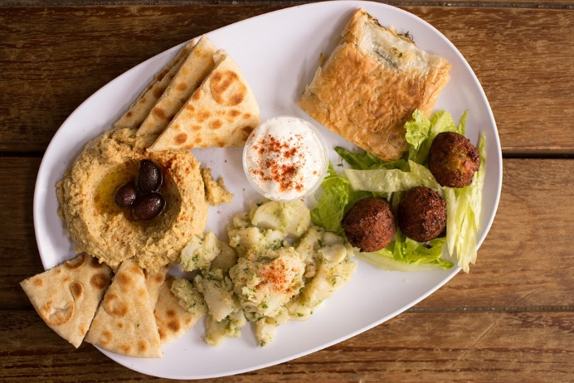
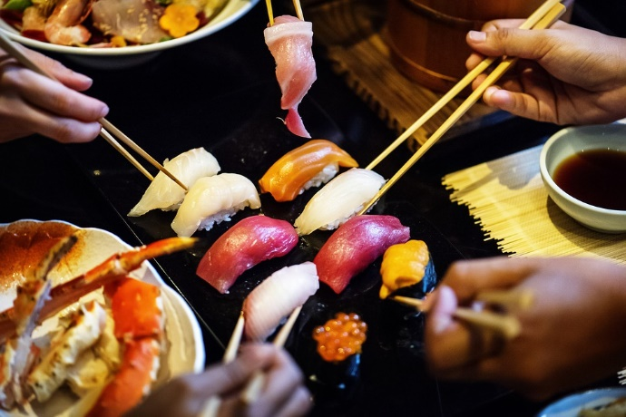
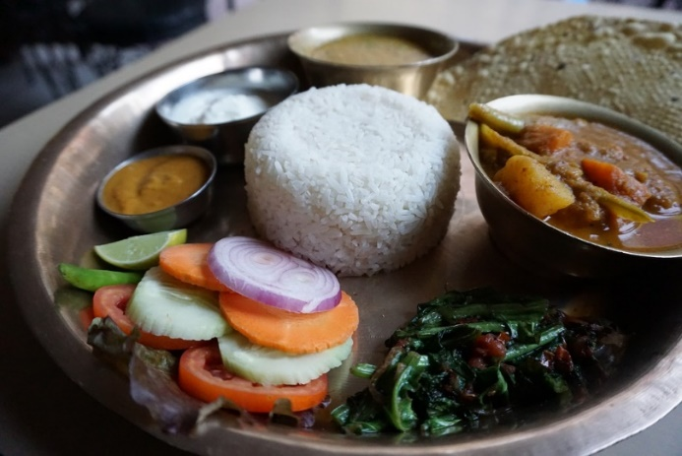
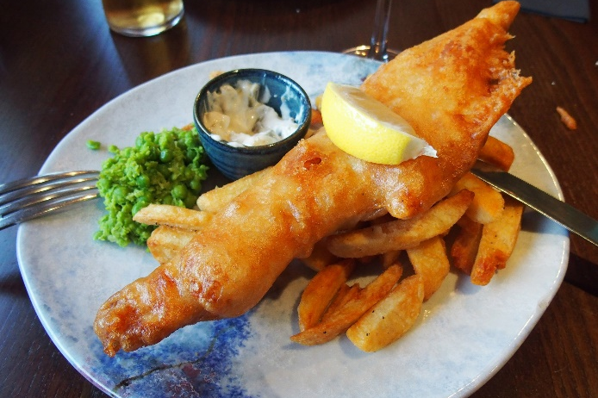
Food from Around the World

Slide 6
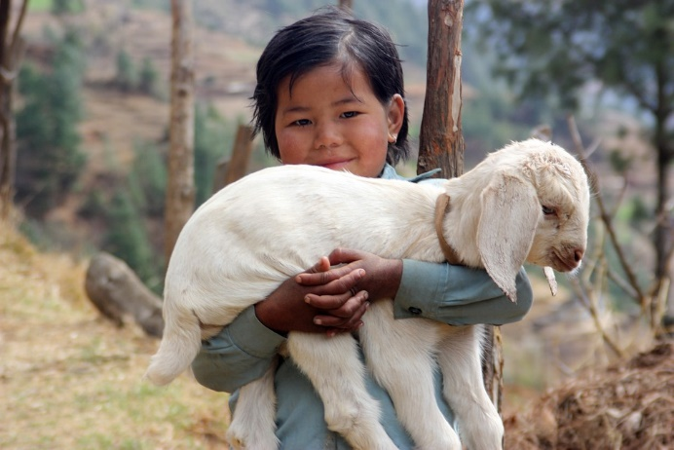
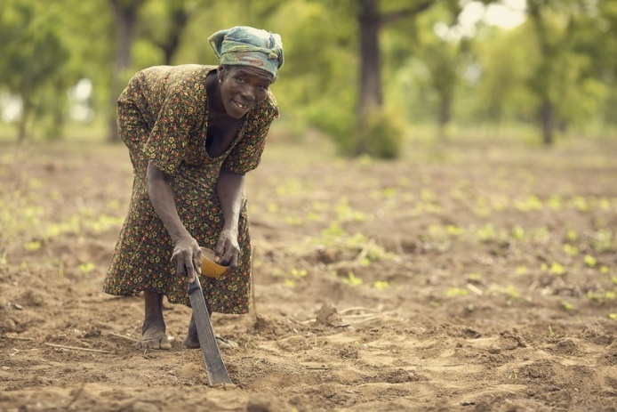
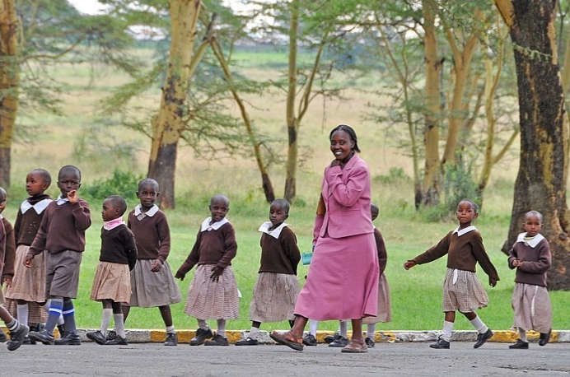
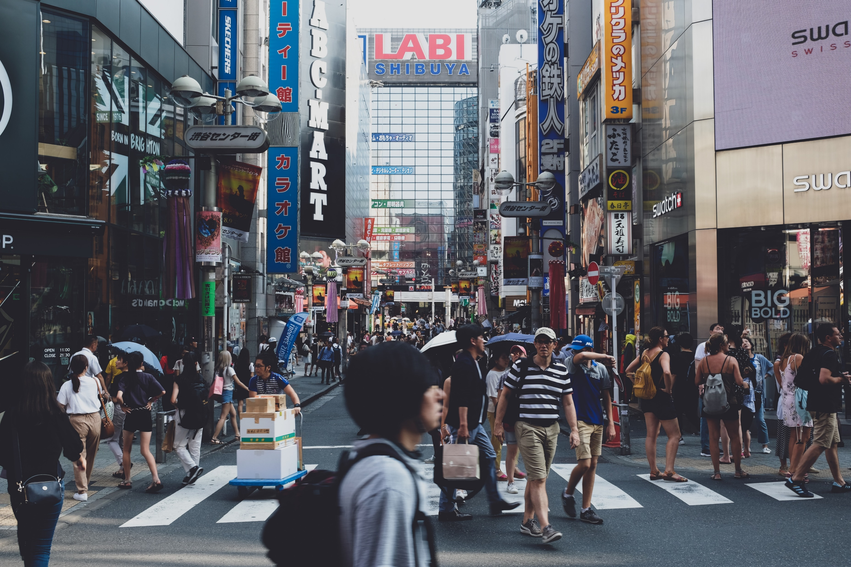
People Around the World

Slide 7
United Kingdom
Who? Children usually live with a parent or parents and siblings. Grandparents usually live in a different place but children may visit them.
What’s Home? Families live in a flat (apartment) or a house, sometimes with a garden. Some children have their own bedroom but some share.
What’s for Dinner? The mother or the father cooks meals and some families sit around a table together and talk. Food usually comes from a supermarket and can sometimes be delivered to the house! Sometimes families order a takeaway or go out to a restaurant to eat.
Did You Know…?
Some children tidy and clean around the house and earn pocket money!

Slide 8
France
Who? Children usually live with their parents and siblings. Families may live very close together in the same village or town so they can see each other often.
What’s Home? Families live in apartments or houses, in cities or the countryside.
What’s for Dinner? Mealtimes are very important family times. Lunch is the biggest meal, at 12 o’clock. It has aperitifs, then the main course and cheeses before dessert. Families have snacks at about 4 o’clock and 8 o’clock.
Did You Know…?
Many children come home from school at lunchtime to eat!

Slide 9
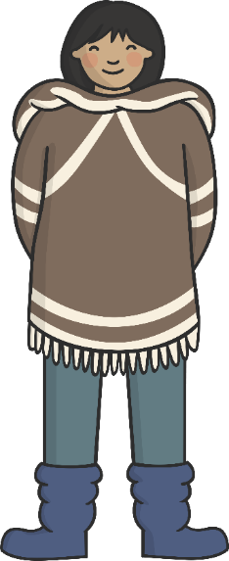
Greenland
Who? Most families living in Greenland are Inuit. Family is very important and children may live with grandparents, aunties, uncles and cousins.
What’s Home? Most families live in homes made from stone or wood. In the summer, families may live in tents made from furs or skins. There are no roads between towns.
What’s for Dinner? Fresh fruit and vegetables come from other countries because the land is mostly ice. Families go hunting and fishing for reindeer, seal and whales. Food should be shared with the whole family.
Did You Know…?
Babies are often given the name of a family member who has died so that person may never be forgotten.

Slide 10
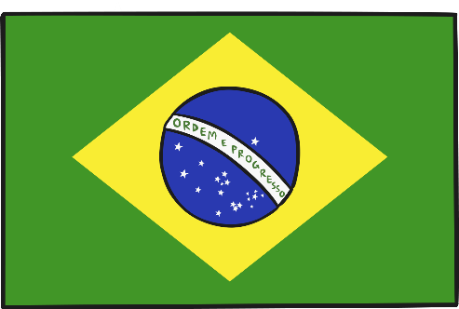
Brazil
Who? Most families are large and stay close together because family is very important. Children often live with their parents and grandparents.
What’s Home? Most Brazilians live in cities. Families may live in small apartments and some families live in a ‘favela’ neighbourhood.
What’s for Dinner? Families eat together. Lunch is usually the biggest meal of the day.
A popular meal is rice and black beans. Meals often end with a strong cup of coffee.
Did You Know…?
Children usually only go to school in the morning or afternoon.

Slide 11
Australia
Who? Australia is very multicultural, so there are lots of different ways people live. Children usually live with their parents and siblings.
What’s Home? Many families live in a 3 or 4 bedroom brick or weatherboard house, sometimes with a big back yard. In the cities, some children live in apartments or houses.
What’s for Dinner? Normally, dinner is eaten at around 6pm. The family sit around a table together and talk. Sometimes people go out to eat. Dinner is often food from all over the world.
Did You Know…?
Around half of Australians were born overseas or have one parent who was born overseas and moved to Australia.

Slide 12
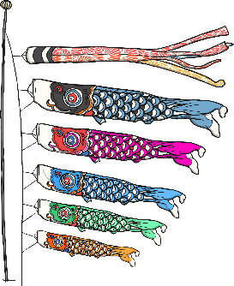
Japan
Who? Children usually live with their parents. Grandparents may live nearby. Families meet often for meals and special occasions. Fathers often work long hours away from home.
Did You Know…?
5th May is a special day to celebrate children and to say thank you to mothers. It is called Kodomo no Hi (Children’s Day).
What’s Home? Families usually live in small apartments or houses. Children may sleep in the same room as their parents. People usually sleep on futons on the floor.
What’s for Dinner? Meals are usually cooked by the mother. Rice and miso soup are popular for all three meals of the day. Chopsticks or spoons are used. Families often sit on cushions on the floor at a low table to eat.

Slide 13
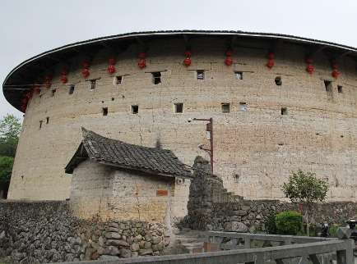
China
Who? Children often live with their parents, grandparents and even great-grandparents! In the past, families were only allowed to have one child. Children are taught to always respect and obey their parents or elders.
What’s Home? Families in cities live in flats in tall housing blocks. In the countryside, whole families live together in a simple house.
What’s for Dinner? Meals are usually cooked by the mother. The same meal may taste different in different parts of the country. Food is cooked in a wok and eaten with chopsticks.
Did You Know…?
In Fujian, a whole village lives in a building called a roundhouse!

Slide 14
Syria
Who? Family life is very important. Children usually live with their parents and grandparents but others meet up every day. Children must do what they are told because they must always respect their parents.
What’s Home? Sadly, there is a war in Syria now. Many families have split up and many people are now refugees. This means they are living very far from home.
What’s for Dinner? Meals are cooked by the mother. Lunch is the biggest meal of the day and is between 2 o’clock and 3 o’clock. Meze has as many as 30 little dishes! Then coffee and sweets come at the end.

Slide 15
Kenya
Who? Families are very important and always help each other. Many children are also looked after by their aunts, uncles and grandparents and family friends.
What’s Home? Usually, people in cities live in houses or apartments made of stone or cement. Elsewhere, some people live in huts of thatch and dried mud.
What’s for Dinner? The women in the family usually cook the meals. Breakfast is chai (tea) and bread but lunch and dinner are usually stews. Dessert can be delicious local fruits, such as mango.
Did You Know…?
4 in 10 people in Kenya are 14 years old or younger.

Slide 16
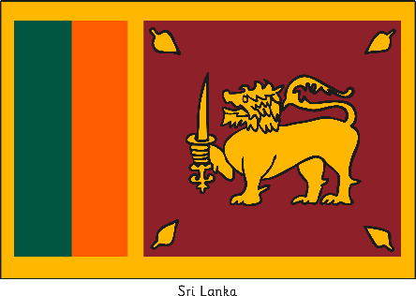
Sri Lanka
Who? Many children live with their parents, grandparents and great-grandparents! The oldest family members are very important and respected.
Did You Know…?
It is rude to touch the top of someone’s head (especially a child’s) because it is the most important part of the body.
What’s Home? Years ago, in the countryside, families would live together in traditional small stick and mud thatched houses. In the cities, they might live in thatch, wood and metal homes.
What’s for Dinner? Meals are sometimes eaten with your hands. Often, there is rice and a spicy curry. Sri Lankan food is the spiciest in the world! Families serve cups of tea when a guest arrives.

Slide 17
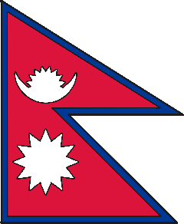
Nepal
Who? Families can be very big. After getting married, a new wife moves into her husband’s family home. Children usually live with their parents and grandparents. Older siblings look after the young children. Sometimes, girls do not go to school.
What’s Home? In the countryside, families live in houses made of stone or mud bricks with thatch roofs and raised eaves . Many homes have just two rooms (one for cooking, one for sleeping).
What’s for Dinner? Families sometimes sit on the floor to eat. Meals are usually eaten with your hands. There is usually rice and lentil soup. Often, families eat pickles, curries and fish with a main meal.
Did You Know…?
Everyone must eat with their right hand.

Slide 18
Ghana
Who? Many families live together in large groups. Sometimes, women stay with their own families even after getting married. Sometimes, men have more than one wife. When a boy grows up, he can go to live with his father or uncle.
What’s Home? Most families live in the countryside. Homes are all on the ground floor. The rooms go around a square courtyard.
What’s for Dinner? Usually, families eat a soup or stew for main meals made from yams or plantains. Families keep chickens and goats for special occasions.
Did You Know…?
People in Ghana speak English first and sometimes local languages too.

Slide 19
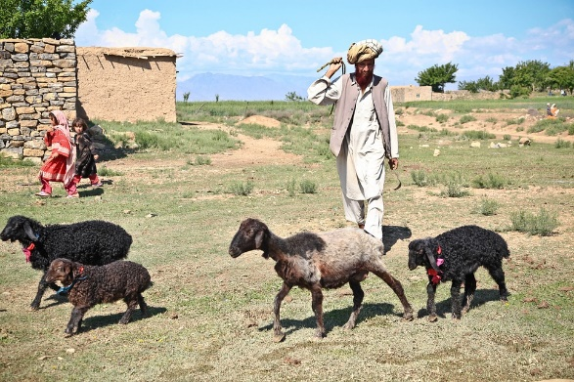
Afghanistan
Who? Families are very big. A new wife moves into her husband’s family home. Children live together with their parents, grandparents, aunties, uncles and cousins.
What’s Home? Most people live in villages in the countryside. Sadly, many families are now refugees and live very far away from home.
What’s for Dinner? People grow crops and have animals to help feed themselves. Meals are usually cooked by the mother. Rice is very popular. Lamb kebabs are eaten from street stalls.
Did You Know…?
If a husband dies, the wife may marry his brother. Men may have to support more than one wife and her children.

Slide 20
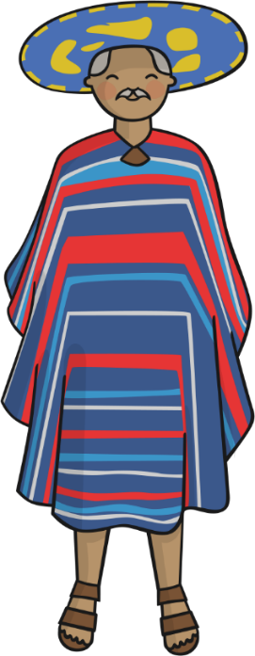
Mexico
Who? Children usually live with their parents. Sometimes, children may live with their grandparents too. Families join together for big occasions such as weddings or festivals.
What’s Home? Many families live in apartments or small houses. The windows look into a small square courtyard. Some people build their own houses and paint them bright colours.
What’s for Dinner? The most important meal is in the afternoon. Main meals have corn, spicy chilli peppers and beans. Many families eat tortillas with their meals.
Did You Know…?
Say ‘Yes’ by pointing a finger up then curling it up and down quickly.

Slide 21
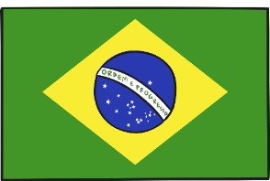
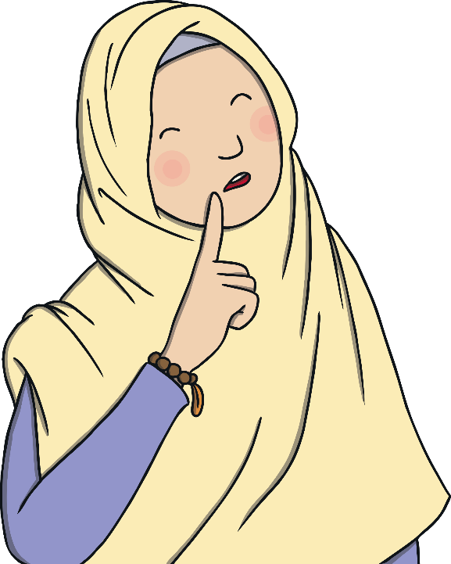
Quiz

Slide 22
Where do families paint their houses bright colours?
A
Greenland
Never mind. Keep trying!
Nepal
B
Never mind. Keep trying!
C
Mexico
Correct!

Slide 23
Which country had a rule that said families were only allowed one child?
A
France
Never mind. Keep trying!
China
B
Yay! Correct!
C
Japan
Never mind. Keep trying!

Slide 24
Which country has the spiciest food in the world?
A
The United Kingdom
Never mind. Keep trying!
Kenya
B
Never mind. Keep trying!
C
Sri Lanka
Yay! Correct!

Slide 25
In which country do families use a wok to cook?
A
China
Yay! Correct!
Brazil
B
Never mind. Keep trying!
C
Ghana
Never mind. Keep trying!

Slide 26
Where do families sleep on futons?
A
Ghana
Never mind. Keep trying!
Japan
B
Yay! Correct!
C
Sri Lanka
Never mind. Keep trying!

Slide 27
Where do men sometimes have more than one wife?
A
The United Kingdom
Never mind. Keep trying!
China
B
Never mind. Keep trying!
C
Ghana
Yay! Correct!

Slide 28
Which country is mostly covered by ice?
A
Kenya
Never mind. Keep trying!
Greenland
B
Yay! Correct!
C
Nepal
Never mind. Keep trying!

Slide 29
Where do children sometimes come home for lunch?
A
Japan
Never mind. Keep trying!
China
B
Never mind. Keep trying!
France
C
Yay! Correct!

Slide 30
Glossary
Back to slide
Aperitifs – In France, light drinks and snacks eaten before a main meal.
Futon – A padded mattress that can be rolled up or folded.
Inuit – the members of an indigenous group of people from northern Canada and parts of Greenland and Alaska
Meze – A selection of hot and cold dishes, such as hummus, olives and pitta bread, served before the main course.
Shack – A roughly built hut or cabin.
Sibling – A brother or a sister.
Thatch – Straw or a similar material used for covering a roof.
Tortilla – A thin, flat pancake made from maize flour.
Wok – A bowl-shaped frying pan typically used in Chinese cooking.

